Slide 1
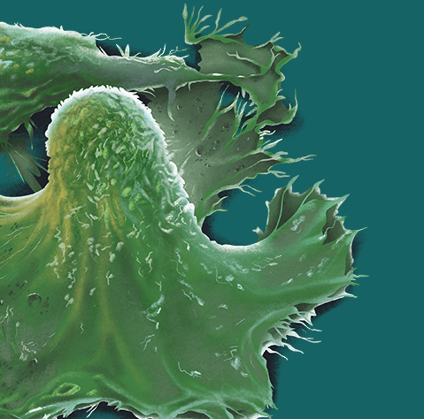
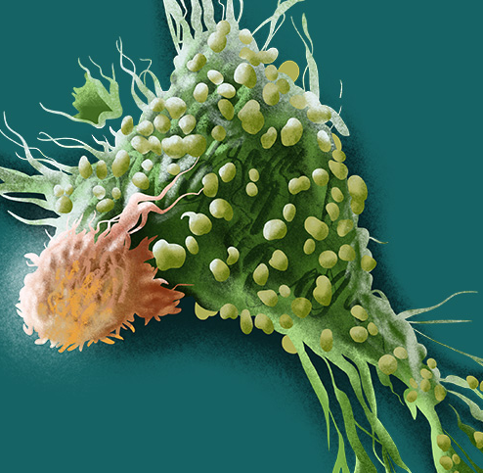
CAR-T CELL THERAPY:
FOCUS ON THE MAIN TOXICITY
Pier Luigi Zinzani, Beatrice Casadei
Istituto di Ematologia “L. e A. Seràgnoli”
Università di Bologna

Slide 2
Timeline
Introduction
Main toxicity:
  Immune mediated toxicities
    Cytokine release syndrome (CRS)
    Immune effector cell-associated neurotoxicity syndrome (ICANS)
  Cytopenia and hypogammaglobulinemia
Conclusion:
  Future strategies to decrease adverse events related with CAR-T cell therapy

Slide 3
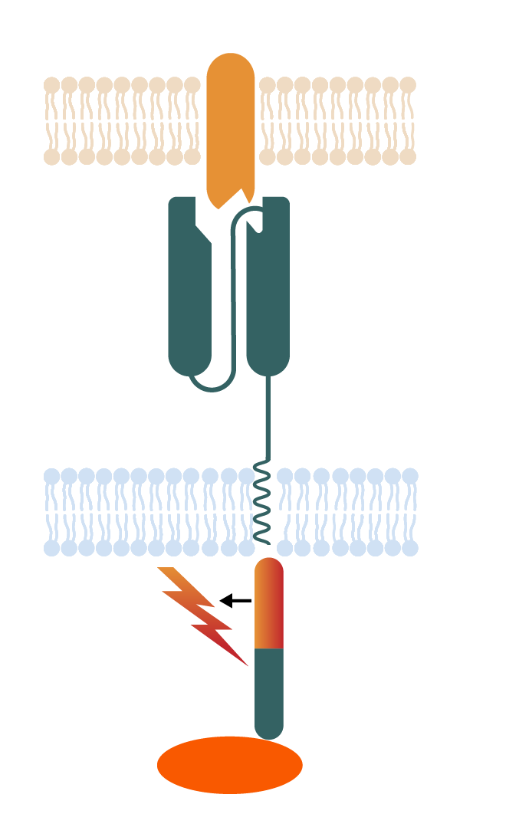
CD-19 targeting CAR-T cell
Tisagenlecleucel (Novartis):
  Approved by AIFA on August 7th, 2019
  Patients up to 25 years of age with B-cell acute lymphoblastic leukaemia (ALL), that is refractory or in second or later relapse (ELIANA trial)
  Adult patients with large B-cell lymphoma relapsed/refractory after 2 or more line
  of systemic therapy, including diffuse large B-cell lymphoma (DLBCL) NOS, high grade B-cell lymphoma, and DLBCL arising from follicular lymphoma (JULIET trial).
Axicabtagene ciloleucel (Kite-Gilead):
  Approved by AIFA on November 13th, 2019
  Adult patients with large B-cell lymphoma relapsed/refractory after 2 or more line
  of systemic therapy, including DLBCL NOS, high grade B-cell lymphoma, primary mediastinal large B-cell lymphoma and DLBCL arising from follicular lymphoma (ZUMA-1 trial).
V_{H}
V_{L}
CD28 or
4-1 BB
CD3ζ
ZAP 70
Early clinical data in follicular lymphoma, multiple myeloma and other malignant disease like glioblastoma are promising and new approvals are expected in the coming years.
2nd generation
(dual signaling)

Slide 4
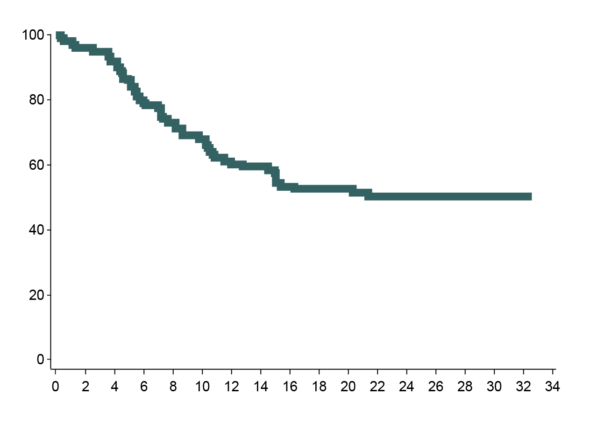
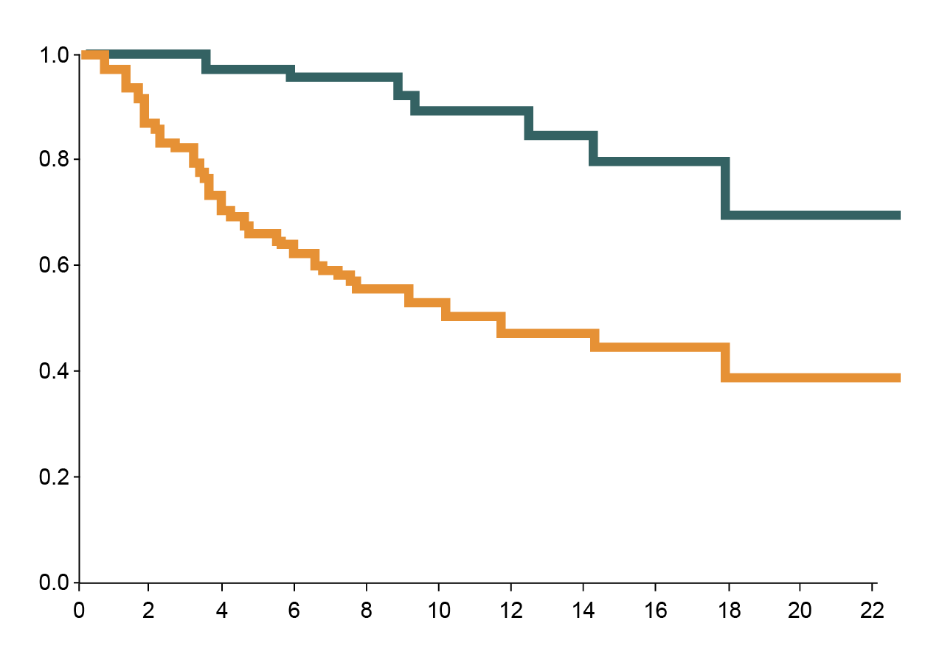
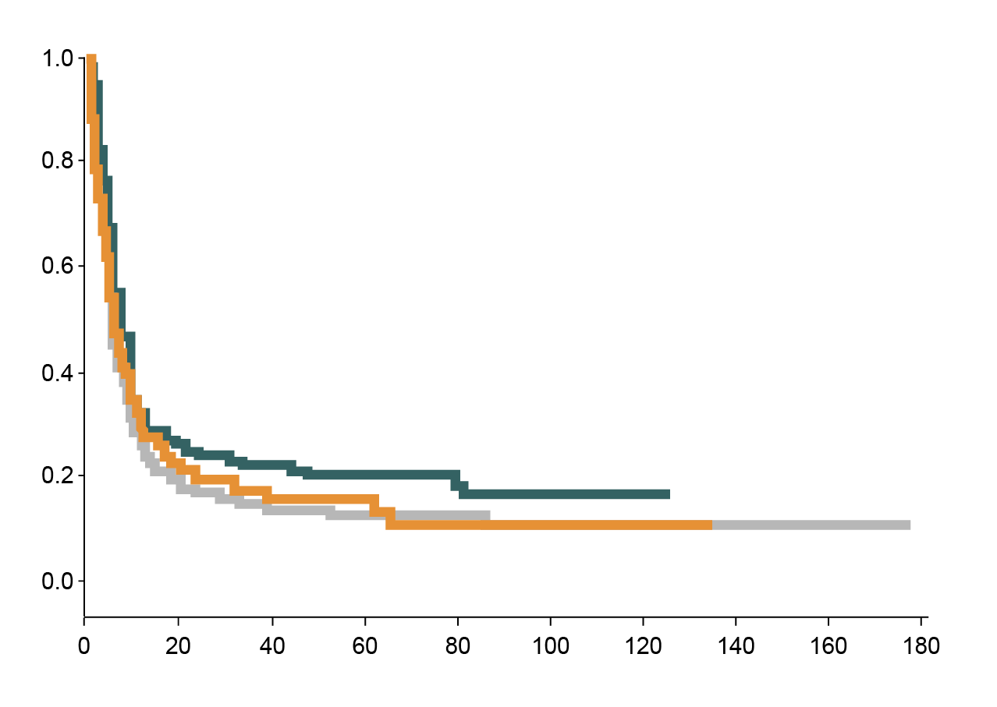
Introduction – Response rate
ZUMA-1, OS
JULIET, OS
SCHOLAR-1, OS
Median OS (95% CI), months
NR (12.8 – NR)
 | Events/N | Median (mo)
Primary refractory | 143/179 | 7.1
Refractory to second-line or later-line | 261/306 | 6.1
Relapsed ≤ 12 mo post-ASCT | 101/118 | 6.2
OS (%)
Probability of Survival
Event-free Probability
OS Rate | Overall
12-mo | 60%
18-mo | 53%
24-mo | 51%
Patients with complete response
All patients
Time (months)
Months since infusion
Months from commencement of salvage therapy
Prodotto CAR-T | Costrutto CAR | Indicazioni | ORR | CR | Median DoR | Median PFS | Median OS
Tisagenlecleucel (JULIET study) | CD19scFv/ 4-1BB/CD3ζ | DLBCL R/R LAL-B R/R (< 25 aa) | 52% | 40% | NR | 4 mo | 12 mo
Axicabtagene ciloleucel (ZUMA-1 study) | CD19scFv/ CD28/CD3ζ | DLBCL R/R PMBCL R/R | 74% | 54% | NR | 5.9 mo | NR
Mod. da Schuster SJ, et al. NEJM 2019; 380: 45-56; Locke FL, et al. Lancet Oncol 2019; 20: 31-42; Crump M, et al. Blood 2017; 130: 1800-1808
Notes:
OS: overall survival; CI: confidence interval; ASCT: autologous stem cell transplantation; PMBCL: primary mediastinal B-cell lymphoma; R/R: relapsed or refractory; ORR: overall response rate; CR: complete response; DoR: duration of response; PFS: progression-free survival; NR: not reported

Slide 5
Immune mediated toxicities - CRS
Cytokine release syndrome (CRS): immune-mediated toxicity characterized by an excessive immune reaction caused by immune-modulating drugs.
ZUMA-1 AE, n (%) | 2-year analysis (N: 108)
Grade > 3 AEs | 106 (98%)
Grade > 3 SAEs | 52 (48%)
Any grade CRS | 94 (93%)
Grade > 3 CRS* | 12 (11%)
JULIET AE, n (%) | 2-year analysis (N: 111)
Grade > 3 AEs | 64 (58%)
Grade > 3 SAEs | 46 (41%)
Any grade CRS | 64 (58 %)
Grade > 3 CRS* | 24 (22%)
Median time to onset: 2 days (1-12)
Median time to resolution: 7 days (2-29)
* grading by Lee et al. 2014
Median time to onset: 3 days (1-9)
Median time to resolution: 7 days (2-30)
* grading by Porter et al. (UPenn)
Mod. da Schuster SJ, et al. NEJM 2019; 380: 45-56; Locke FL, et al. Lancet Oncol 2019; 20: 31-42
Notes:
AE: adverse event; SAE: serious adverse event

Slide 6
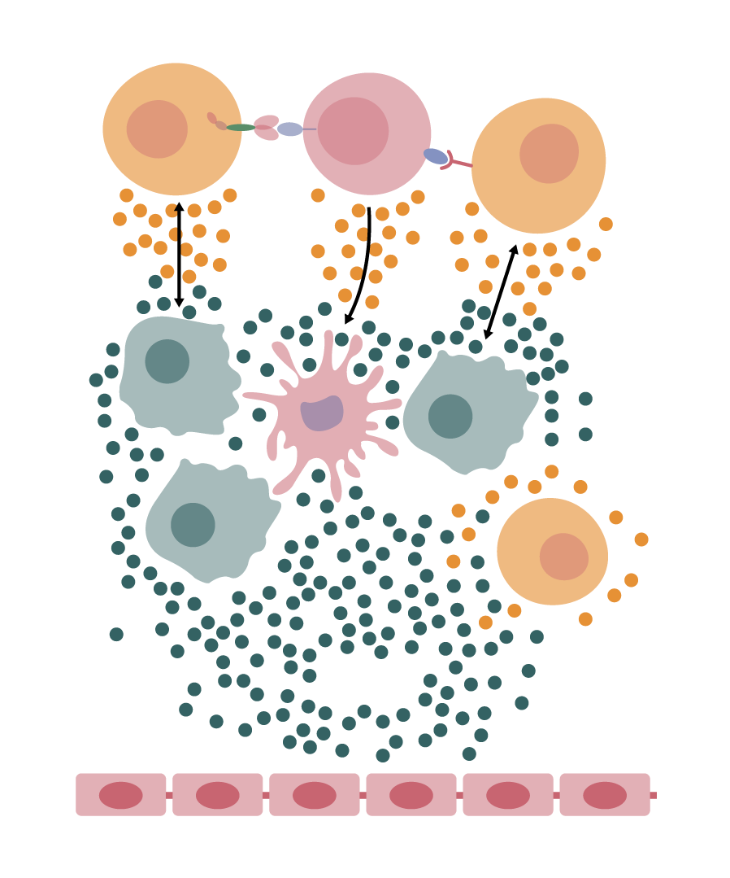
CRS - Pathophysiology
Activated
T-cell
Lysed
lymphocyte
Activated
T-cell
CAR-T
cell
CAR
B
cell
Activated T cells, lysed B lymphocytes: IFN-γ, TNF-⍺
Macrophages: IL-6, TNF-⍺, IL-10, IL-1
Endothelial cells: Ang-2, vWF, IL-6
CD-19
CD-19
T
cell
CD-3
IFN-γ, TNF-α
IL-6, MCP-1
GM-CSF
Macrophage
Dentritic
cell
Macrophage
Early increase of IL-6 and angiopoietin2: angiopoietin1 ratio are associated with very severe CRS.
IL-6 has been implicated in key pathogenetic aspects of CRS like vascular leakage, CID, cardiomyopathy.
IFN-γ, TNF-α
IL-8
Macrophage
T
cell
IL-6, Ang-2
vWF
Endothelial cells
Lymphocyte derived factors IFN-γ, TNF-α
Non lymphocyte derived factors IL-6, GM-CSF, IL-1, IL-8, IL-10, TNF-α, MCP-1 (CCL2), Ang-2, vWF
Mod. da Borrega JC. et al. Hemasphere 2019; 3: e191; Norelli M et al, Nat Med 2018; 24: 739-748; Faramand R, et al. Blood 2019; 132 (suppl_1): 95; Hunter CA, et al. Nat Immunol 2015; 16: 448-457
Notes:
IFN: interferon; TNF: tumor necrosis factor; IL: interleukin; CID: coagulazione intravascolare disseminata; MPC-1: monocyte chemoattractant protein-1; vWF: von Willebrand factor; GM-CSF: granulocyte-macrophage colony-stimulating factor

Slide 7
CRS – Clinical presentation
Blood test
Prolonged cytopenias
Coagulopathy
Electrolyte
Acute renal injury
Transaminitis
C-reactive protein
Ferritin elevations
Differential diagnosis:
Sepsis: Severe CRS is associated with higher risk for infections (immune paralysis during CRS?)
Hemophagocytic lymphohistiocytosis/macrophage activation syndrome
TLS (can concur with CRS)
Mod. da Grupp SA, et al. NEJM 2013; 368: 1509-1518; Lee DW, et al. BBMT 2019; 25: 625-638
Notes:
MOF: multiple organ failure; TLS: tumor lysis syndrome

Slide 8
CRS grading and management
temperature > 38°C
flu-like symptoms
nausea
infectious workup
broad spectrum antibiotic
supportive measures (antipyretics)
CRS grade 1
temperature > 38°C
hypotension not requiring vasopressors
hypoxia requiring low-flow nasal cannula or blow-by
manage fever and symptoms as grade 1
transfer to IMC/ICU
low dose vasopressor
tocilizumab 8 mg/kg i.v.
CRS grade 2
temperature > 38°C
hypotension requiring one vasopressor with or without vasopressin
hypoxia requiring high-flow face mask
manage fever and symptoms as grade 2
repeat tocilizumab
low dose corticosteroids
CRS grade 3
temperature > 38°C
hypoxia requiring positive airway pressure
hypotension requiring multiple vasopressors (excl. vasopressin)
manage fever and symptoms as grade 2
high dose corticosteroids
consider further individual treatment
CRS grade 4
The severity of CRS seems to be the only factor associated with infection.
Patients with severe CRS present prolonged cytopenia and develop more frequent invasive mold infections.
Mod. da Lee DW, et al. BBMT 2019; 25: 625-638
Notes:
IMC: intermediate care unit; ICU: intensive care unit

Slide 9
Immune mediated toxicities - ICANS
Immune effector cell-associated neurotoxicitity syndrome (ICANS)
ZUMA-1 AE, n (%) | 2-year analysis (N: 108)
Grade > 3 AEs | 106 (98%)
Grade > 3 SAEs | 52 (48%)
Any grade NEs | 65 (64%)
Grade > 3 NEs** | 35 (32%)
JULIET AE, n (%) | 2-year analysis (N: 111)
Grade > 3 AEs | 64 (58%)
Grade > 3 SAEs | 46 (41%)
Any grade NEs | 23 (21%)
Grade > 3 NEs** | 13 (12%)
Median time to onset: 5 days (1-17)
Median time to resolution: 13 days (1-191)
** grading by CTCAE ver 4.03
Median time to onset: 6 days (1-17)
Median time to resolution: 14 days
** grading by CTCAE ver 4.03
10% of patients experience CNS toxicity in the absence of CRS.
In the other 90% of patients CNS toxicity appears concurrent with CRS or following its resolution.
Mod. da Schuster SJ, et al. NEJM 2019; 380: 45-56; Locke FL, et al. Lancet Oncol 2019; 20: 31-42
Notes:
CNS: central nervous system

Slide 10
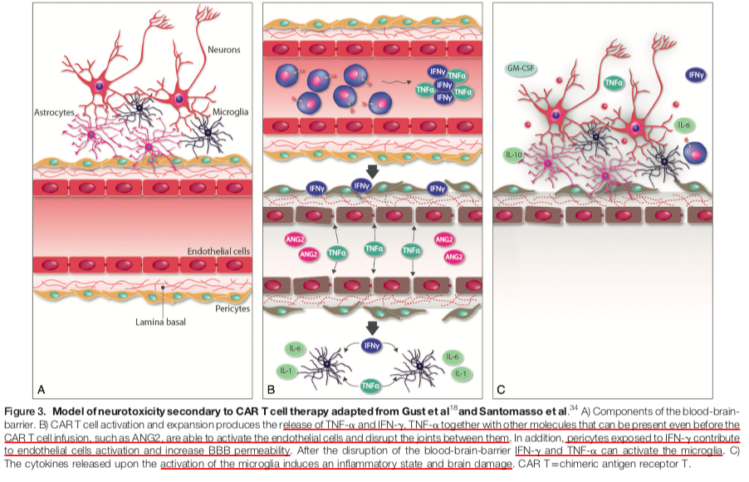
ICANS - Pathophysiology
CAR-T cells, lysed B cells: IFN-γ, TNF-⍺
Macrophages: IL-6, TNF-⍺, IL-10, IL-1
Endothelial cells : Ang-2, vWF, IL-6
Disruption of BBB
Microglia activation
Intrathecal cytokines induce an
inflammatory state and brain damage
Mod. da Yañez L, et al. Hemasphere 2019; 3: e186; Gust J, et al. Cancer Discov 2017; 7: 1404-1419; Santomasso BD, et al. Cancer Discov 2018; 8: 958-971

Slide 11
ICANS – Clinical presentation
Risk factor for a severe ICANS:
Severe CRS/systemic inflammation
Tumour burden prior to CAR-T cell infusion
Higher CAR-T cell doses
Higher CAR-T cell peak expansion values
Neurological comorbidities.
Mod. da Lee DW, et al. BBMT 2019; 25: 625-638

Slide 12
ICANS grading and management
awakens spontaneously
fatigue
ICE: 7-9 points
supportive care
IV hydration
neurology consultation
EEG/MRI
consider antiepileptic drug
ICANS grade 1
awakens to voice
delirius/somnolent
ICE: 3-6 points
supportive care as grade 1
consider ICU transfer
consider antiepileptic drug, if not started
low dose corticosteroids (i.e. dexamethasone 10 mg)
ICANS grade 2
awakens to tactile stimulus
ICE: 0-2 points
local edema on imaging
seizure, that resolves with intervention
supportive care as grade 2
ICU trasfer
continous corticosteroids (i.e. dexamethasone 10 mg every 6 hours) and antiepileptic drugs
repeat MRI
ICANS grade 3
comatose
ICE: 0
cerebral edema
life-threatening (>5min) seizure
motor weakness
supportive care as grade 3
high dose corticosteroids specific neurointensive treatment (status epilecticus, brain edema)
consider further individual treatment
ICANS grade 4
Mod. da Lee DW, et al. BBMT 2019; 25: 625-638
Notes:
ICE: immune effector cell-associated encephalopaty

Slide 13
SCORE ICE: Immune Effector Cell-associated Encefaphalopathy
 | Punteggio
Orientamento | Chiedere al paziente □ anno, □ mese, □ città e □ ospedale (totale 4 punti)
Denominazione | Chiedere al paziente di nominare 3 oggetti (es. □ penna, □ orologio □ bottone) (massimo 3 punti)
Compiti semplici su comando | Chiedere al paziente di eseguire compliti semplici (es. mostrare due dite o chiudere gli occhi □) (massimo 1 punto)
Scrittura | Chiedere al paziente di scrivere una frase semplice □ (massimo 1 punto)
Attenzione | Chiedere al paziente di contare all’indietro (es. partendo da 100 □) (massimo 1 punto)
Totale | …………/10

Slide 14
ICANS + CRS - Management
Grado | Terapia di supporto | Tocilizumab | Steroidi | Follow-up
CRS grado 1
+ ICANS grado 1 | Standard of care | NO | NO | Stretta osservazione (vedi rispettive tabelle)
+ ICANS grado >2 (è il grado ICANS che guida la gestione della tossicità) | Trasferimento in ICU | NO | Si Desametasone 10 mg ev x 4 volte/die | Se migliora fino a tornare ICANS grado 1: tapering dello steroide in 3-4 giorni Se non migliora: prosegui steroide e supporto intensivo
CRS grado > 2
+ ICANS grado 1 | Trasferimento in ICU se CRS grado 3-4, considera se grado 2 | Si tratta solo la CRS a seconda del grading (vedi tabella sulla gestione della CRS)
+ ICANS grado 2 | Trasferimento in ICU | Si tratta la CRS come da tabella 2 ma si inizia sempre metilprednisolone 1 mg/kg x 2 volte/die, anche se CRS grado 2
+ ICANS grado 3 | Trasferimento in ICU
+ ICANS grado 4 | Trasferimento in ICU

Slide 15
  Cytopenia and hypogammaglobulinemia
Cytopenia:
Most common AE of grade >3
Related to conditioning regimen, cytokine released during CRS, exposure to multiple prior chemotherapy treatment.
Neutropenia is the most common cytopenia
  78% of patients in ZUMA-1 and 64% patients in JULIET trial developed PMN <1000/mm³
  GCSF is not recommended during the first 3 weeks after CAR-T cell infusion or until CRS has resolved
Severe thrombocytopenia was seen in 38% of patients in ZUMA-1 and 11% of patients in JULIET trial
Hypogammaglobulinemia:
Secondary to the persistence of CAR-T and subsequent development of B-cell aplasia
Incidence: 15% of patients with DLBCL
IgG levels usually fall 1 to 3 months after CAR-T infusion
The presence of hypogamma is associated with the achievement of a complete response
Replacement treatment is reserved to those patients with severe or recurrent infections
Notes:
PMN: polymorphonuclear; GCSF: granulocyte-colony stimulating factor

Slide 16
  Conclusion - Strategies to mitigate toxicities
Prevention of CRS
and neurotoxicity
Risk adapted therapy
Cytokine release prophylaxis
PREVENTION
Selective antigens
(κ and γ light chain)
Deleting the target
antigen on normal HSC
Optimizing the CAR
(dual and affinity-tuned CAR)
Clinical features
(fever ≥ 38.9 °C)
Serum biomarkers
(IL-6, IFN-γ, IL-13, MIP1α, MCP-1..)
PROMPT RECOGNITION
Prevention of
“on-target/off tumor effect”
SWITCH
ON/OFF
Diminishing the
activity of the CAR
Suicide genes
Destruction of the CAR-T cell by mAb
Switch on/off CAR
Risk of CRS and ICANS is mainly related to: disease burden, CAR-T cell construct and dose infused, recipient factors
Notes:
HSC: hematopoietic stem cells

Slide 17
  Conclusion – CAR-T cell team
HEMATOLOGIST
DATA MANAGER
CELLULAR PROCESSING LAB
PATIENT
RADIOLOGIST
CARDIOLOGIST
APHERESIS UNIT
INTENSIVE CARE
UNIT
PHARMACIST
NEUROLOGIST

