Slide 1
I CAR-T nel 2021
Armando Santoro
U.O. Oncologia Medica ed Ematologia
Humanitas Research Hospital
Milano

Slide 2
Queste diapositive possono essere utilizzate anche per creare nuove presentazioni, nel rispetto del riconoscimento delle fonti.
Nessuna parte della presentazione può essere riprodotta o diffusa a scopo commerciale senza il permesso scritto di Accademia Nazionale di Medicina.

Slide 3
Indice
From trials to real word evidence in DLBCL
Open issues in CAR-T therapy
Relapse after first line: BELINDA and TRASNFORM trials
CAR-T in mantle cell lymphoma
CAR-T in follicular lymphoma
Future perspective: NK, tandem CD19+CD20, allo-CAR T

Slide 4
1
From trials to real word evidence in DLBCL

Slide 5
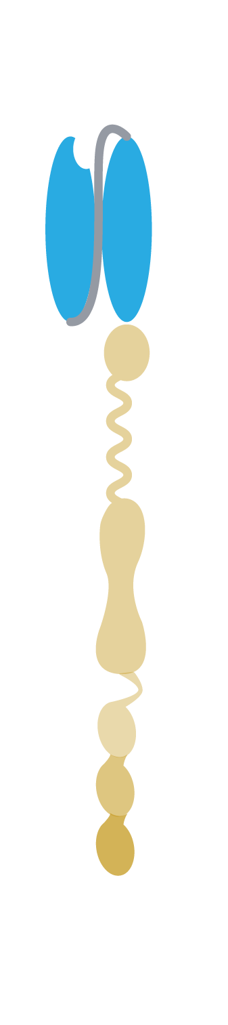

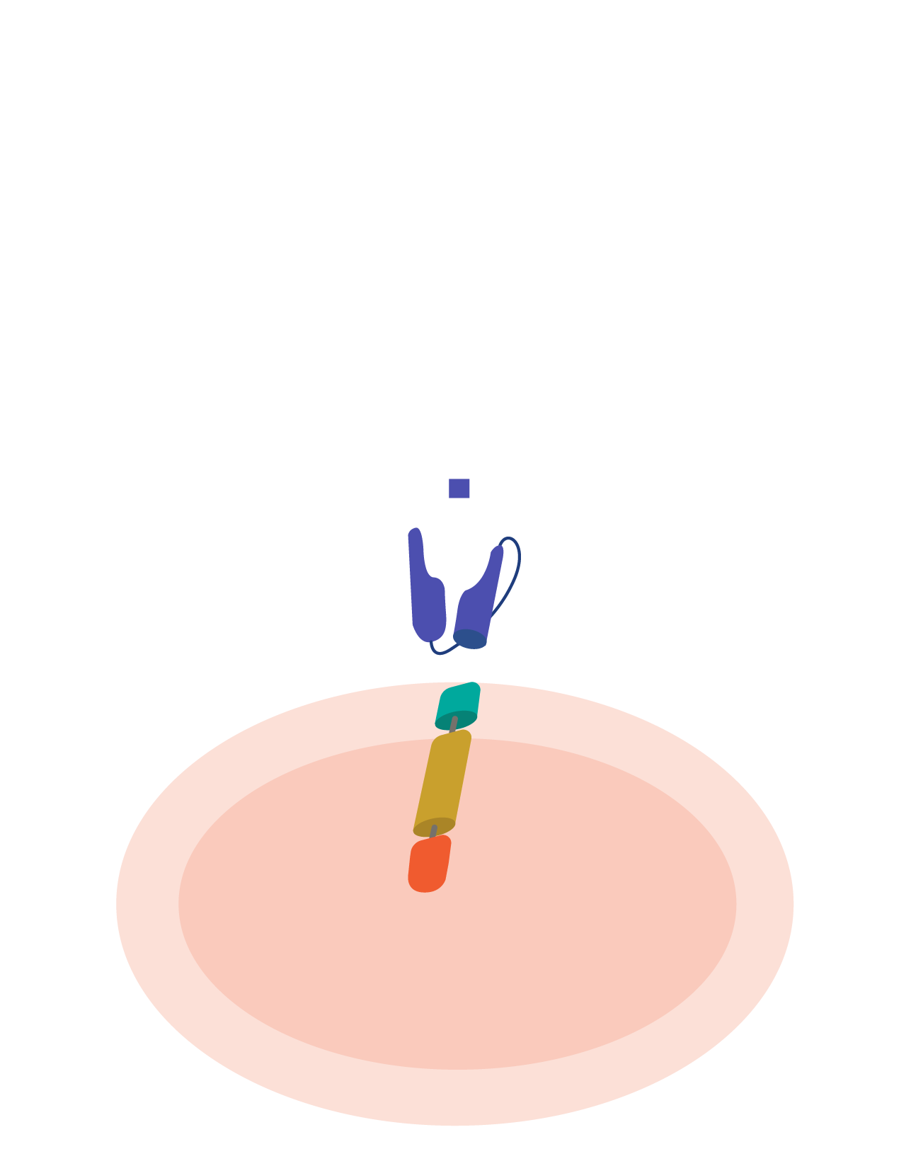
Trial
JULIET trial
ZUMA-1 trial
JCAR 017 trial
Tisagenlecleucel (tisagen)
Axicabtagene ciloleucel (axi-cel)
Lisocabtagene maraleucel (liso-cel)
V_{L}
Antigen-binding
(CD19) domain
Tumor cell
scFv (anti-CD19)
V_{H}
CD8-α hinge
and transmembrane
domain
Tumor antigen
Epitope
Hinge/
Transmembrane
scFv
Transmembrane
domain
Spacer
T cell
4-1BB costimulatory domain
Signal 2: CD28
Intracellular
costimulatory domain
T cell
Signaling sequence
Signal 1: CD3ζ
CD3-ζ signaling domain
CD19 scFv murine
monoclonal FMC63
Transmembrane
domain
Signaling
domain
Transduction
marker
EF1p
3’ LTR
VL
linker
VH
CD28tm
4-1BB
CD3ζ
T2A
huEGFRt
Spacer

Slide 6
JULIET: Tisagen in relapse/refractory DLBCL
238 patients were screened
for eligibility
71 were excluded during screening
2 were still undergoing screening at data cutoff
165 enrolled in the study
50 discontinued study before infusion
12 could not have CAR-T cells manufactured
38 had other reasons
4 were awaiting infusion at data cutoff
111 received an infusion
95 received an infusion in the main cohort
93 received an infusion ≥3 months before cutoff date
2 received an infusion <3 months before cutoff date
16 received an infusion in cohort A
13 received an infusion ≥3 months before cutoff date
3 received an infusion <3 months before cutoff date
DLBCL: diffuse large B-cell lymphoma
Mod. da Schuster SJ, et al. N Engl J Med 2019; 380: 45–56

Slide 7
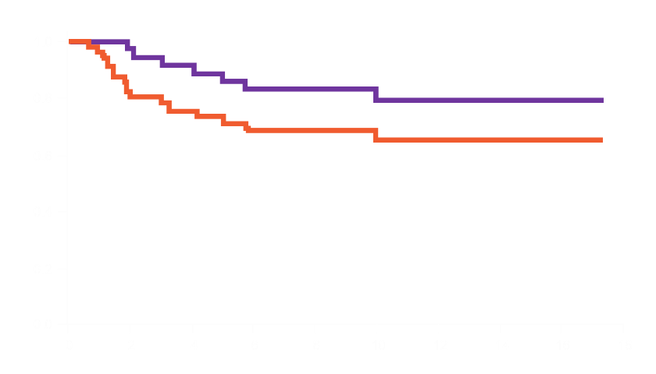
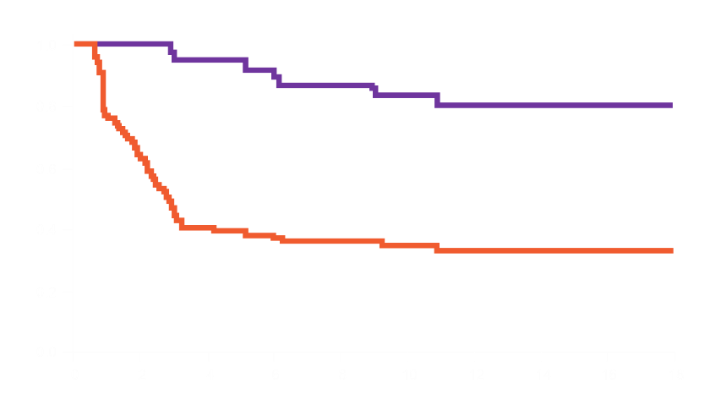
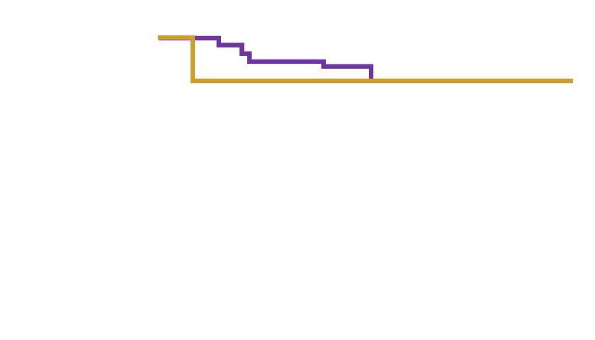
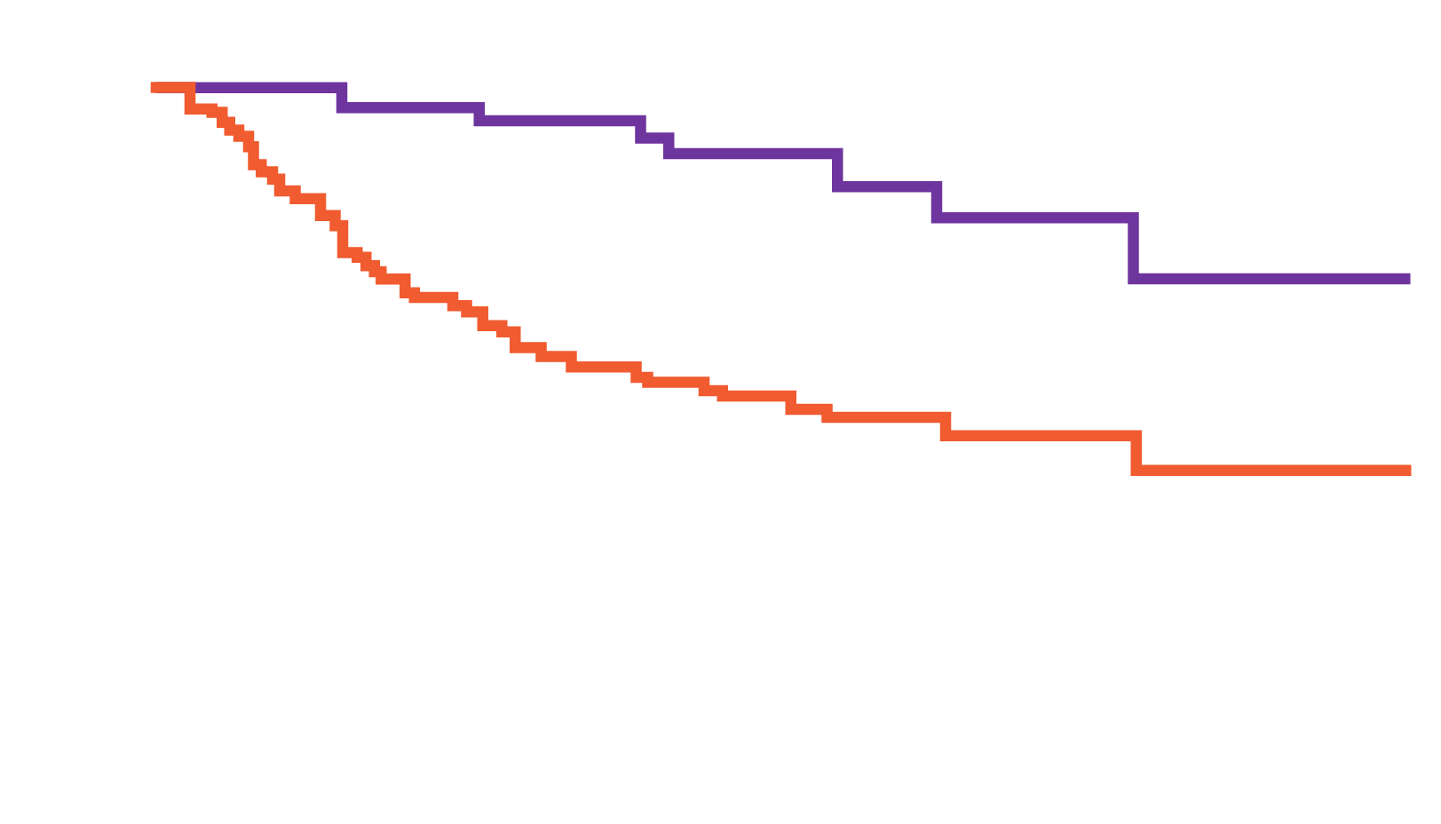
JULIET: Results
DURATION OF RESPONSE
PROGRESSION-FREE SURVIVAL
Probability of maintaining response
Median duration among all patients NR
(95% CI, (10 – NR)
Probability of remaining progression-free
Patients with complete response
All patients
The median OS among patients who received an infusion was 12 months
The estimated probability
of survival at months 12
was 49% (95% CI, 39 – 59)
Patients with complete response
All patients
Months since first response
Months since infection
PFS AMONG PATIENTS WITH A RESPONSE
OVERALL SURVIVAL
Probability of remaining progression-free
Probability of survival
Patients with complete response at month 3
Patients with partial response at month 3
Patients with complete response
All patients
Months
Months
Mod. da Schuster SJ, et al. N Engl J Med 2019; 380: 45–56

Slide 8
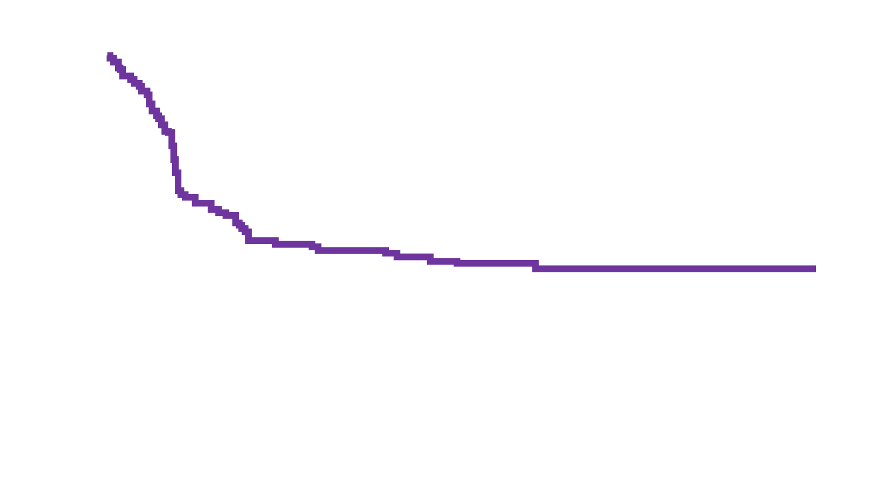
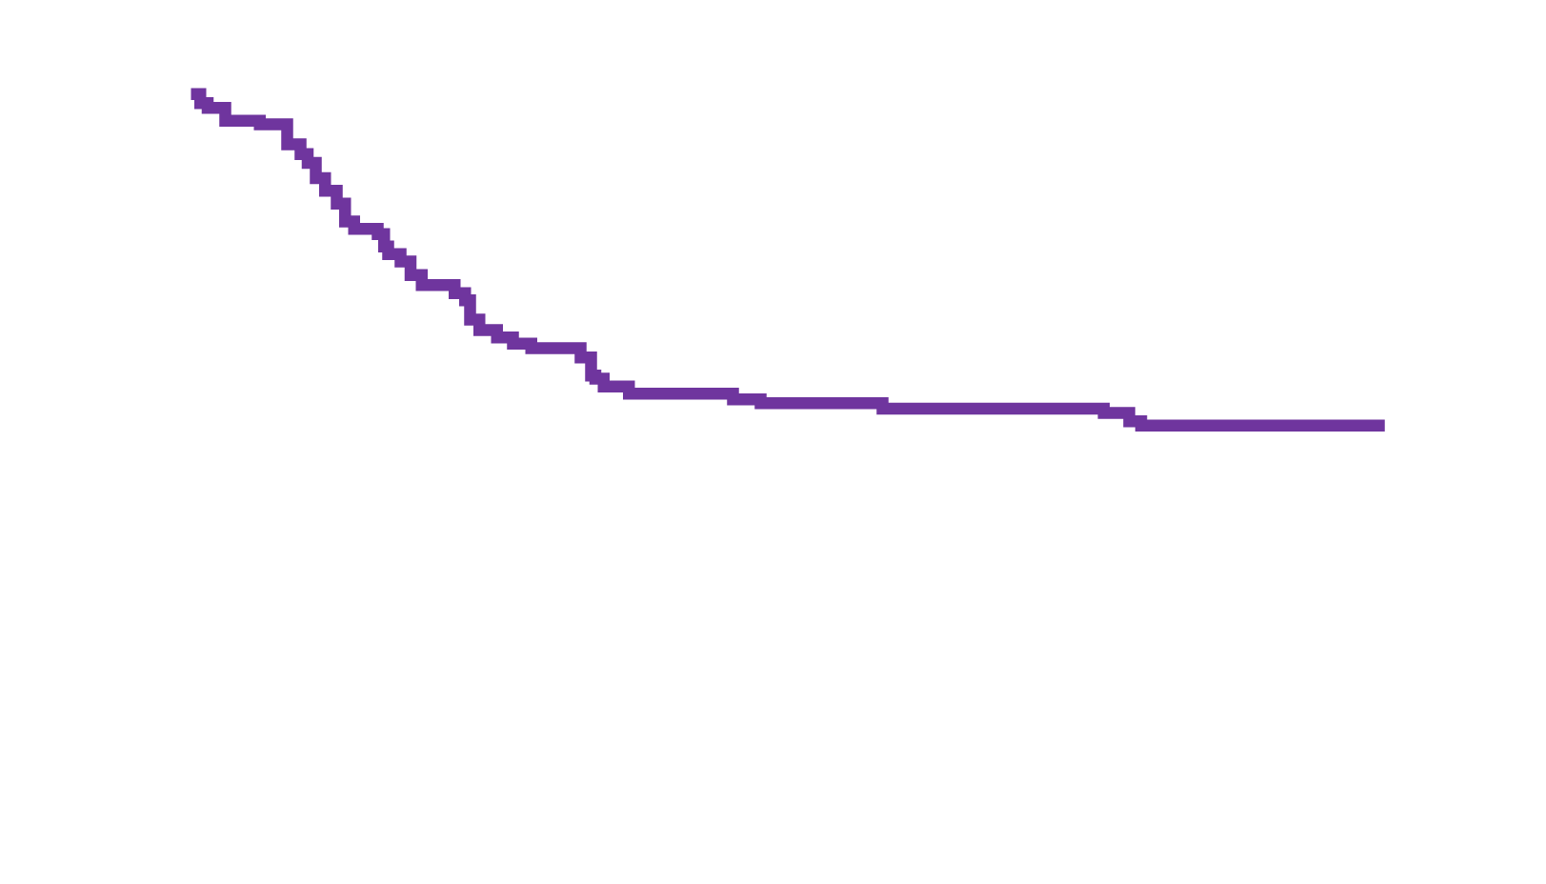
ZUMA-1: Axi-cel in refractory LBCL
PFS with 2 years of follow-up
ZUMA-1 is the pivotal, multicenter, single-arm phase I/II study evaluating axi-cel, an autologous anti-CD19 CAR-T cell therapy in patients with refractory LBCL
After a median follow-up of 27.1 months for cohorts 1 (DLBCL) and 2 (PMBCL/TFL)
N=101
83% ORR; 58% CR rate
51% 2-year OS rate
Median OS not reached
PFS (%)
2-year PFS rate: 39%
Time (months)
OS with 3 years of follow-up
After a median follow-up of 39.1 months
47% 3-year OS rate
4 deaths since 2-year follow-up
Approximately 60% of patients relapse or progress after axi-cel
Previous analysis suggested 2 potential mechanisms of relapse
Loss of CD19 and/or involvement of immune tumor microenvironment in progression biopsy samples
OS (%)
47%
Median OS: 25.8 months (95% CI 12.8–NE)
Time (months)
LBLC: large B-cell lymphoma; NE: not evaluable; ORR: objective response rate;
CR: complete response
Mod. da Neelapu SS, et al. N Engl J Med 2017; 377: 2531–2544; Topp MS, et al. Blood 2019; 134 (Suppl_1): 243; Neelapu SS, et al. Blood 2019; 134 (Suppl_1): 203

Slide 9
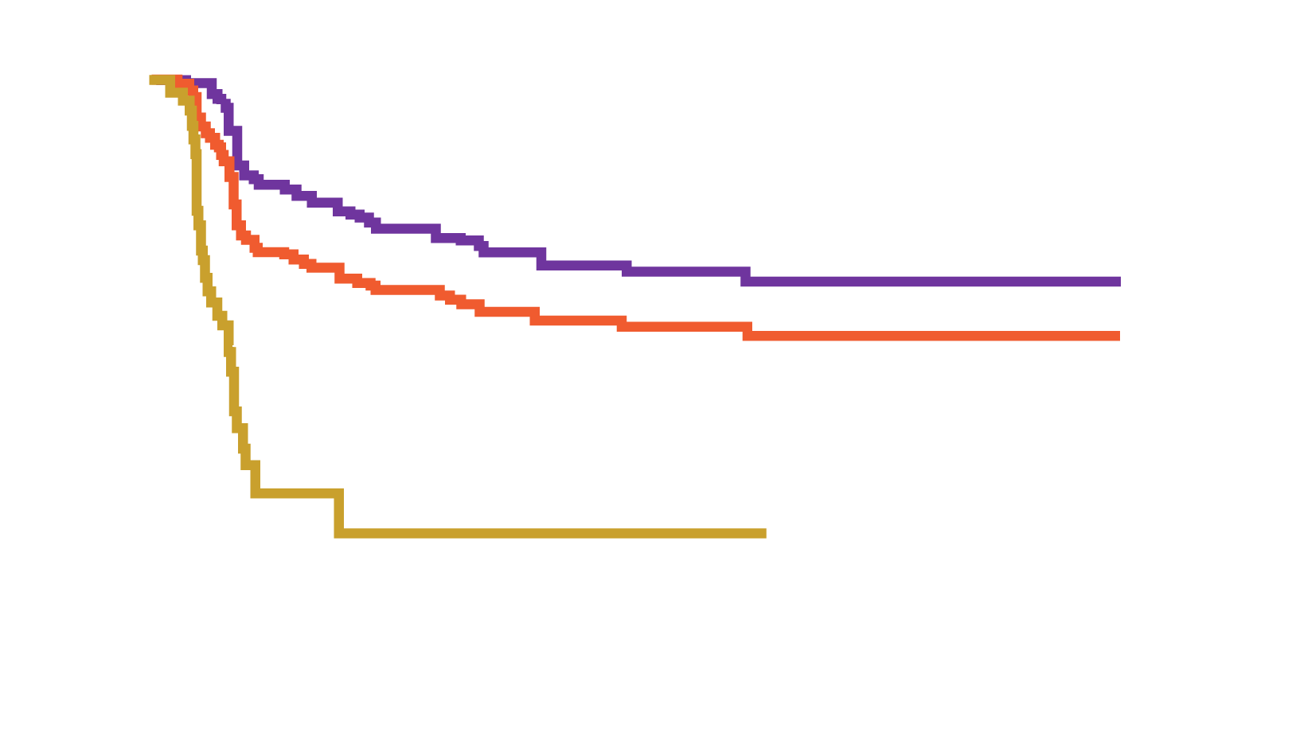
TRANSCEND NHL 001: Pivotal phase I, multicenter design study
Efficacy-evaluable patients (N=256)
ORR (95% CI) | 73% (67–78)
CR rate (95% CI) | 53% (47–59)
Time to first CR or PR, median (range), months | 1.0 (0.7–8.9)
DoR at 6 months (95% CI), % | 60.4 (52.6–67.3)
DoR at 12 months (95% CI), % | 54.7 (46.7–62.0)
Median follow-up (95% CI): 12.0 (11.2–16.7) months
CR – Median (95% CI): NR (NR–NR) months
Total – Median (95% CI): NR (8.6–NR) months
PR – Median (95% CI): 1.9 (1.1–2.1) months
Probability of continued response (%)
Months
Efficacy among patients who received nonconforming product (n=25) was similar to those who received liso-cel
PR: partial response
Mod. da Abramson JS, et al. Blood 2019; 134 (Suppl_1): 241

Slide 10
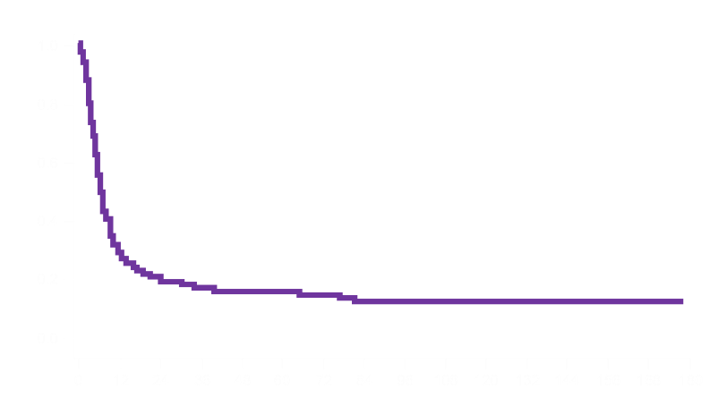
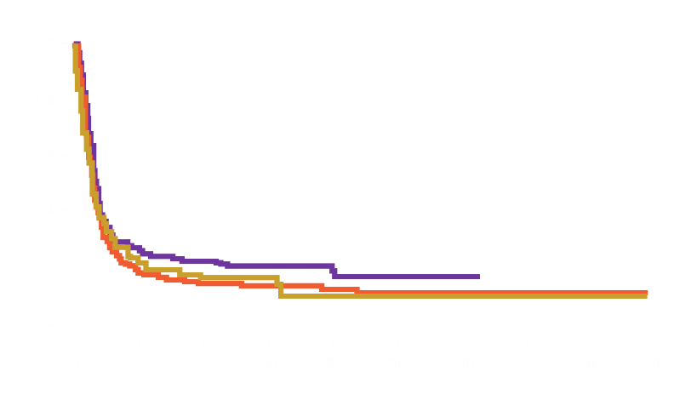
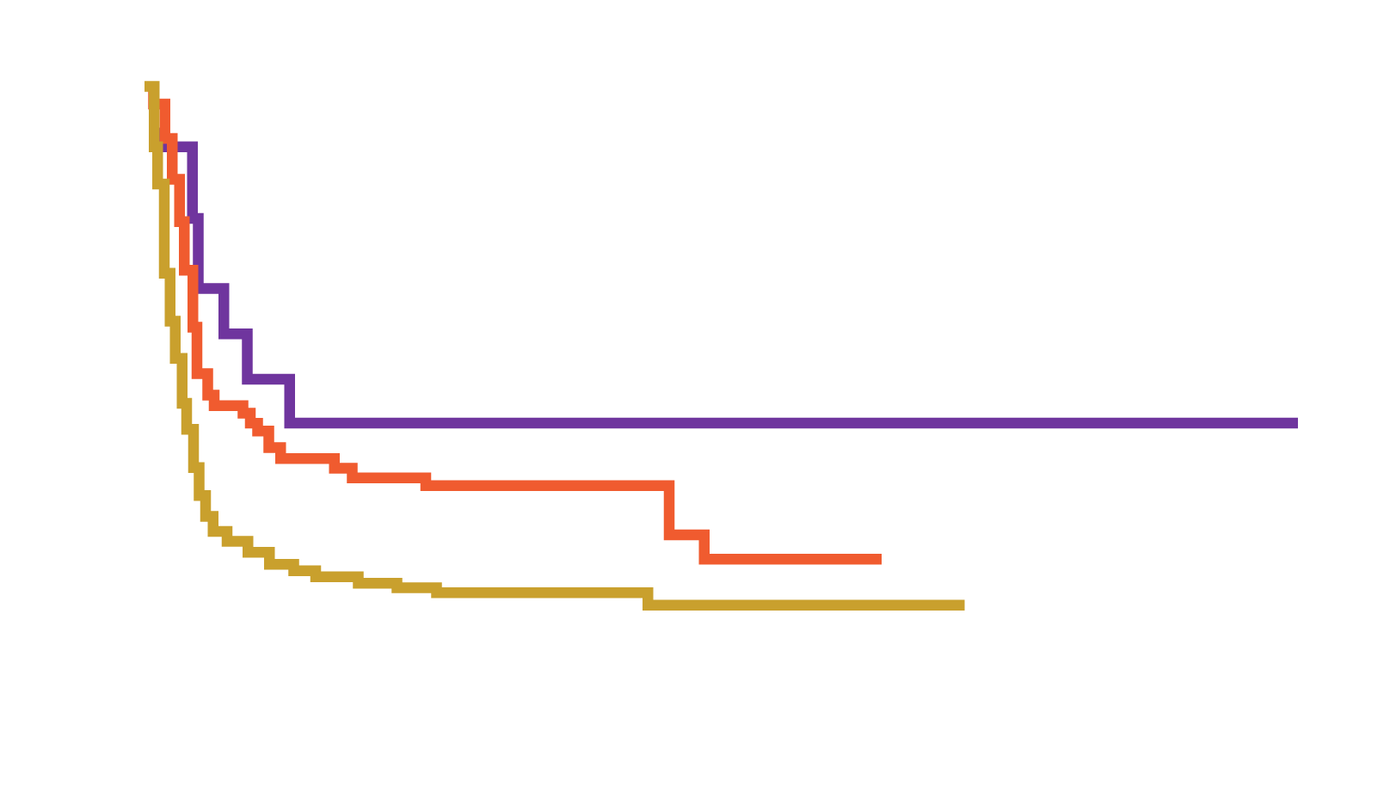
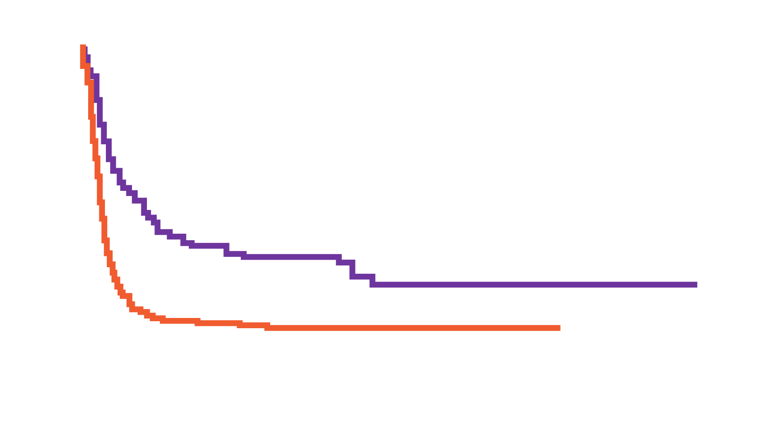
SCHOLAR-1 study
 | Events/N | Median (months)
All | 505/603 | 6.3
 | Events/N | Median (months)
Primary refractory | 143/179 | 7.1
Refractory to second or later-line | 261/306 | 6.1
Relapsed ≤12 months post-ASCT | 101/118 | 6.2
 | Median OS (months) | 2-year survival
All | 6.3 | 20%
7% CR
26% ORR
Event-free probability
Event-free probability
Months from commencement of salvage therapy
Months from commencement of salvage therapy
 | Events/N | Median (months)
CR | 9/18 | 14.9
PR | 47/63 | 6.9
Non-responder | 258/291 | 4.6
 | Events/N | Median (months)
Yes | 123/180 | 14.4
No | 382/423 | 5.1
 | Median OS (months) | 2-year survival
Primary refractory | 7.1 | 24%
Refractory to ≥2 lines of therapy | 6.1 | 17%
Relapse ≤12 months after auto-SCT | 6.2 | 19%
Event-free probability
Event-free probability
Months from commencement of salvage therapy
Months from commencement of salvage therapy
ASCT: autologous stem cell transplantation
Mod. da Crump M, et al. Blood 2017; 130: 1800–1808

Slide 11
Efficacy in multicenter CD19 CAR-T trials in adult NHL
Patient characteristics and outcomes: Comparison between pivotal clinical trials and commercial axi-cel and tisa-cel
 | ZUMA-1¹ | Commercial axi-cel | JULIET² | Commercial tisa-cel
N patients collected | 111 | 163 | 165 | 79
N patients infused | 101 | 149 | 111 | 75
Age, median (range) | 58 (23–76) | 58 (18–85) | 56 (22–76) | 67 (36–88)
DLBCL including HGBL | 76% | 86% | 79% | 94%
ECOG 0/1 | 100% | 86% | 100% | 94%
Prior autologous transplant | 23% | 29% | 49% | 23%
ORR | 82% (best) | 72% (day 30) | 52% (best) | 59% (day 30)
CR rate | 58% (best) | 43% (day 30) | 40% (best) | 44% (day 30)
Grade 3 or higher CRS | 13%ª | 13%^{d} | 22%^{c} | 1%^{d}
Grade 3 or higher NEs | 31%^{b} | 41%^{d} | 12%^{b} | 3%^{d}
Tocilizumab use | 43% | 62% | 14% | 13%
Steroid use | 27% | 57% | 10% | 7%
12 deaths (8%) unrelated to lymphoma progression occurred in axi-cel patients at a median of 57 days (range 6–373), with 5 due to infectious complications, 4 due to grade 5 NEs, 1 due to cardiac disease, 1 due to pulmonary hemorrhage, and 1 due to HLH.
4 deaths (6%) unrelated to lymphoma progression occurred in tisa-cel patients at a median of 48 days (range 25–146) with 2 due to infectious complications, 1 due to cardiac disease, and 1 due to unknown causes.
ª Per Lee scale; ^{b} Per CTCAE V4.03; ^{c} Per Penn scale; ^{d} Per institutional scale which includes a,b,c, ASTCT, and CARTOX scale
HGBL: high-grade B-cell lymphoma; CRS: cytokine release syndrome; NEs: neurologic events; HLH: hemophagocytic lymphohistiocytosis
Mod. da Riedell PA, et al. Blood 2019; 134 (Suppl_1):1599
1. Neelapu SS, et al. N Engl J Med 2017; 377: 2531–2544; 2. Schuster SJ, et al. N Engl J Med 2019; 380: 45–56

Slide 12
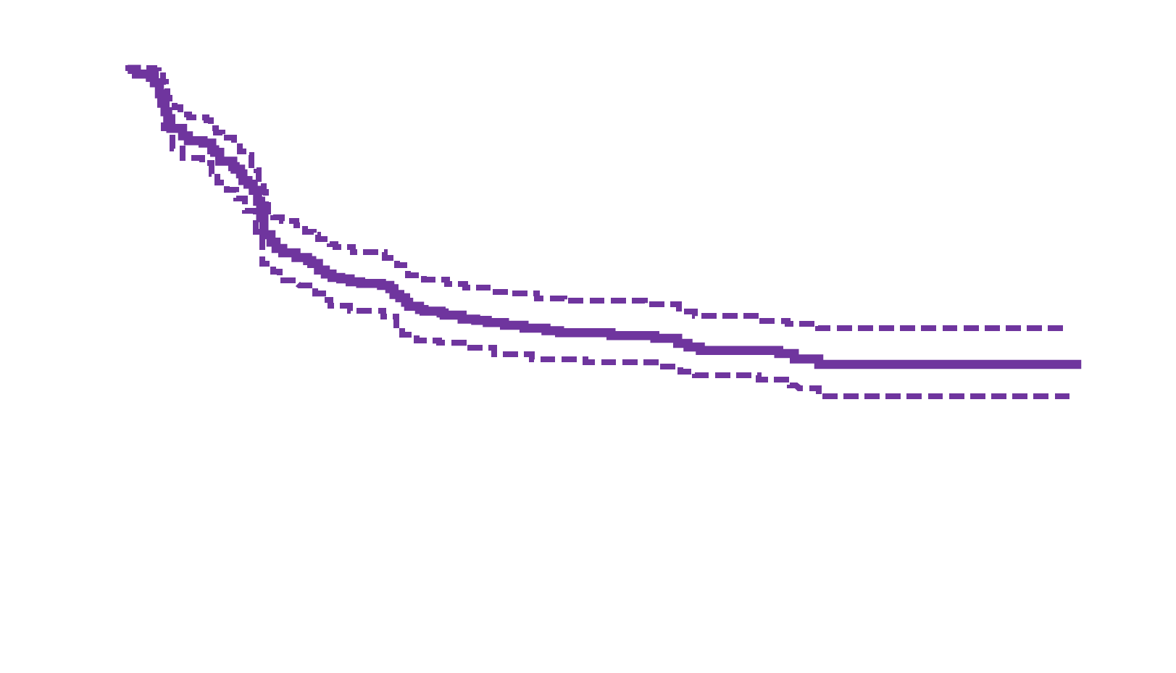
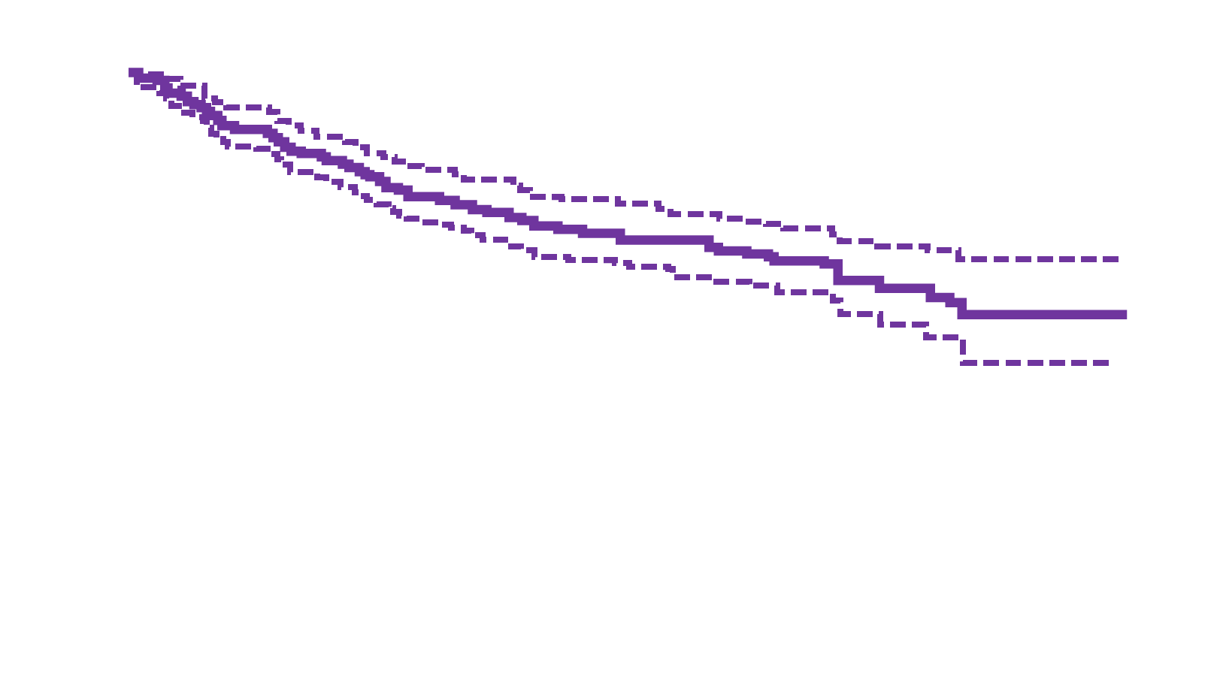
Axi-cel in relapse/refractory LBLC
12 months PFS: 45%
12 months OS: 64%
Median PFS: 8.31 months
95% CI: 6.04–15.1 months
PFS (probability)
OS (probability)
Time (months)
Time (months)
Mod. da Nastoupil LJ, et al. J Clin Oncol 2020; 38: 3119–3128

Slide 13
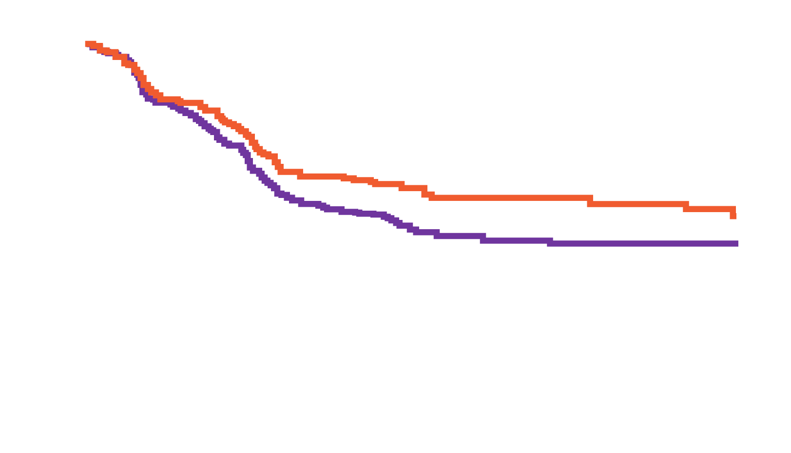
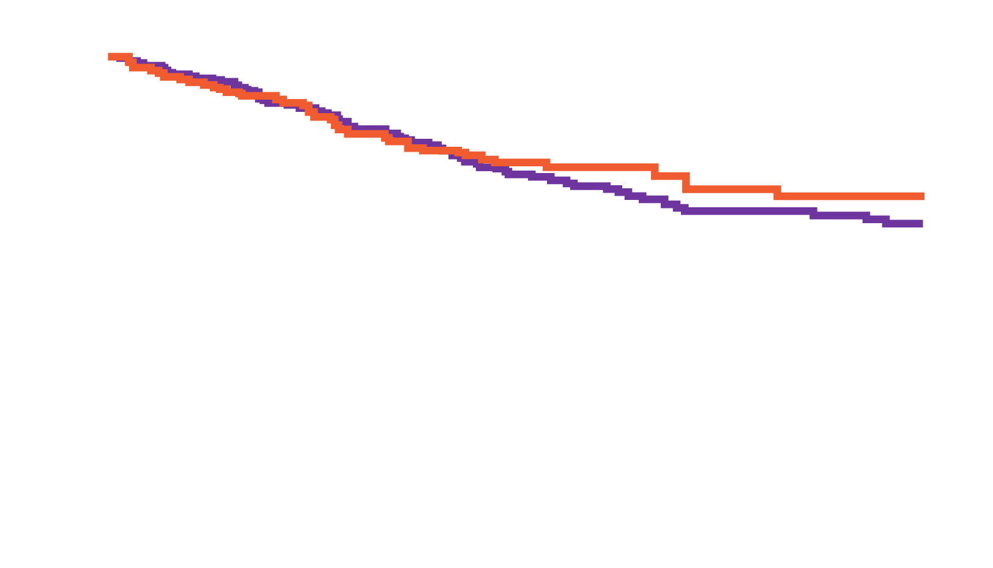
Axi-cel in RWE from the CIBMTR registry
Survival outcomes after axi-cel for LBCL
PFS
OS
p=0.059
p=0.618
Probability (%) of event free
Probability (%) of event free
Age ≥65
Age <65
Age ≥65
Age <65
Time from date of infusion (months)
Time from date of infusion (months)
Median follow-up: 6 months (range 1–14 months)
RWE: real world evidence
Mod. da Pasquini MC, et al. Blood 2019; 134 (Suppl_1): 764

Slide 14
Tisagen in RWE from the CIBMTR registry
Comparison to JULIET pivotal trial
 | CIBMTR registry N=83 (%) | JULIET N=115 (%)
ORR | 60 | 54
CR | 38 | 40
DoR at 3 months | 75 | 76
PFS at 3 and 6 months | 62/33 | 46/39
OS at 3 and 6 months | 80/67 | 83/61
CRS (grade ≥3) | 4 | 23
Neurotoxicity (grade ≥3) | 5 | 11
Mod. da Jaglowski S, et al. Blood 2019; 134 (Suppl_1): 766

Slide 15
2
Open issues in CAR-T therapy

Slide 16
CAR-T cell therapy: More than one step
Leukapheresis
Manufacturing
Infusion
Activity
Collect patient’s white blood cells
Isolate and
activate T cells
Engineer T cells with CAR gene
Targeting element
(e.g. CD19, BCMA, CD20)
Expand
CAR-T cells
Infuse same patient with CAR-T cells
CD19
Spacer
Transmembrane
Viral vector with CAR DNA
Costimulatory domains (e.g. CD28 or 4-1BB)
CAR-engineered
T cell
CD3ζ (essential signaling domain)
Median manufacturing time: 17–28 days
Patients undergo lymphodepleting (and possibly salvage/bridging) therapy
Mod. da Majors BS, et al. Abstract PS1156; Lim WA, June CH. Cell 2017; 168: 724–740; Sadelain M, et al. Nat Rev Cancer 2003; 3: 35–45; Brentjens RJ, et al. Nat Med 2003; 9: 279–286; Park JH, et al. Blood 2015; 126: 682; RCP Axicabtagene ciloleucel®; RCP Tisagenlecleucel®

Slide 17
Leukapheresis
Week | -12 | -11 | -10 | -9 | -8 | -7 | -6 | -5 | -4 | -3 | -2 | -1 | Schedule leukapheresis (day 0)
Allogeneic
HSCT, DLI
Stopping rules for ongoing therapies prior to apheresis (HD CAR-1). Guidelines established for the HD-CAR-1 study at the University Hospital Heidelberg.
Bendamustine
Vaccination with live virus vaccines
PEG-asparaginase, lenalidomide
CAUTION WITH BENDAMUSTINE OR STEROIDS BEFORE APHERESIS (manufacturing failures)
Growth factor (long acting, e.g. pegfilgrastim)
Inotuzumab-ozogamicin, polatuzumab-vedotin, blinatumomab
MTX (intrathecal), cyclophosphamide
Growth factor (short acting, e.g. filgrastim)
Steroids
Rituximab, obinutuzumab
BTK-inhibitors (e.g. ibrutinib)
HSCT: hematopoietic stem cell transplantation; DLI: donor lymphocyte infusion,; MTX: methotrexate; BTK: Bruton tyrosine kinase; PEG: pegylated
Mod. da Korell F, et al. Cells 2020; 9: 1225

Slide 18
Patient journey
Follow-up
at least every 3 months
Relapse or
resistance
Apheresis
Patients should be monitored daily for the first 10 days folllowing infusion for signs and symptoms of CRS, NE and other AEs
Patients should be advised to remain within proximity of a qualified clinical facility for at least 4 weeks following infusion
Bridging
therapy
(if required)
DLBCL or
PMBCL
Relapse or
resistance
CAR-T cell
infusion
day
-30
day
-5
day
-3
day
0
10 days
post-infusion
4 weeks
post-infusion
months
1–3
months
6–24
+24
months
1st systemic
therapy
Patient
identification
After the first
10 days, the patient should be monitored at the physician’s discretion
Follow-up
at least every 6 months
Lymphodepleting
chemotherapy
2nd systemic
therapy
Follow-up
at least every months
PMBCL: primary mediastinal B-cell lymphoma

Slide 19
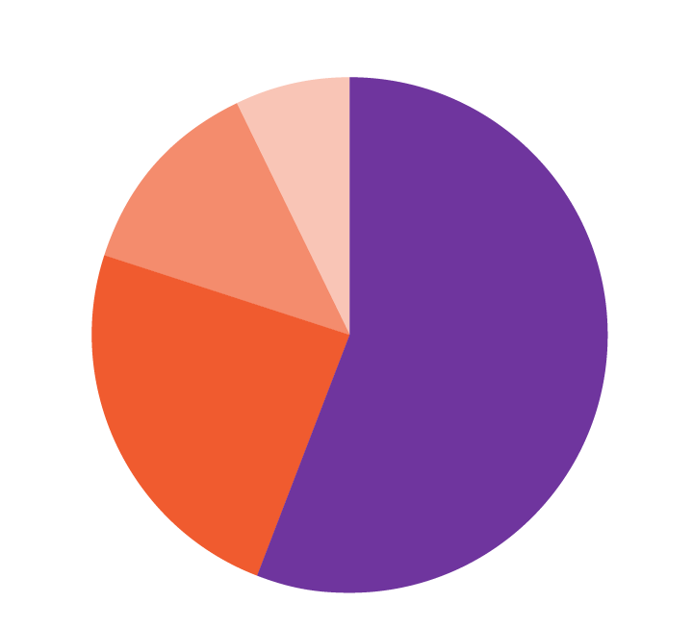
Bridge to CAR-T
Baseline characteristics | ZUMA-1^{1, 2} (N=101) | 6-centre retrospective cohort analysis^{3, a} (N=104) | 17-centre retrospective cohort analysis⁴ (N=295)
Median age, years (range) | 58 (23–76) | 64 (21–80) | 60 (21–83)
ECOG PS 0/1, % | 100 | 90 | 81
IPI score ≥3, % | 46 | 46 | 55
DLBCL, % | 76 | 43 | 68
Prior auto-SCT, % | 21 | 27 | 33
Bridging chemotherapy, % | 0 | 40 | 55
Objective response rate | 82 | 71 | 81^{c}
Complete response, % | 58 | 44 | 57^{c}
CRS, any grade | 97 | 94 | 92^{b}
CRS grade ≥3 | 12 | 16 | 7^{b}
Neurologic AEs, any grade | 65 | 76 | 69^{b}
Neurological AEs grade ≥3 | 31 | 39 | 33^{b}
7%
13%
Chemotherapy
Steroids
56%
Radiation
24%
Other
Median follow-up: 15.4 months. Response assessment: ª Per institutional practices; ^{b} For mITT population (n=274); ^{c} At data BCL
ECOG PS: Eastern Cooperative Oncology Group performance status; IPI: International Prognostic Index;
mITT: modified intention to treat
Real-world use of bridging therapy does not appear to influence the efficacy or safety profile of axi-cel
1. Neelapu SS, et al. N Engl J Med 2017; 377: 2531–2544; 2. RCP Axicabtagene ciloleucel®; 3. Jacobson C, et al. Blood 2018; 132 (Suppl_1): 92; 4. Nastoupil LJ, et al. Blood 2018; 132 (Suppl_1): 91

Slide 20
The impact of bridging therapy among patients with relapsed and refractory LBCL treated with commercially available axi-cel
Leukapheresis
(n=148)
 | All patients (n=124) | No bridging (n=62) | Bridging (n=62) | p value
Age >60 | 64 (52%) | 32 (52%) | 32 (52%) | 1.00
ECOG PS 2–3 | 17 (14%) | 4 (7%) | 13 (21%) | 0.03
HGBL-DH/TH | 23 (19%) | 7 (11%) | 16 (26%) | 0.09
IPI ≥3 | 68 (55%) | 27 (44%) | 41 (66%) | 0.02
Bulky disease (≥ 10 cm) | 33 (27%) | 11 (18%) | 22 (36%) | 0.04
LDH >2x ULN | 26 (22%) | 8 (13%) | 18 (31%) | 0.03
BT (n=81)
ST (n=61)
RT (n=11)
CMT (n=9)
Disease progression (n=21)
CR to BT (n=1)
Failed manufacturing(n=2)
Axi-cel infusion
(n=124)
BT: bridging therapy; ST: systemic therapy; RT: radiation therapy; CMT: combined modality therapy;
HGBL-DH/TH: high-grade B-cell lymphoma with MYC and BCL2 and/or BCL6 rearrangements;
LDH: lactate dehydrogenase; ULN: upper limit of normal
Mod da Pinnix CC, et al. Blood Adv 2020; 4: 2871–2883

Slide 21
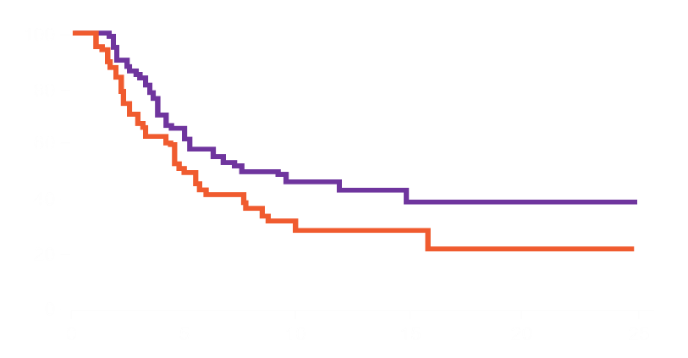
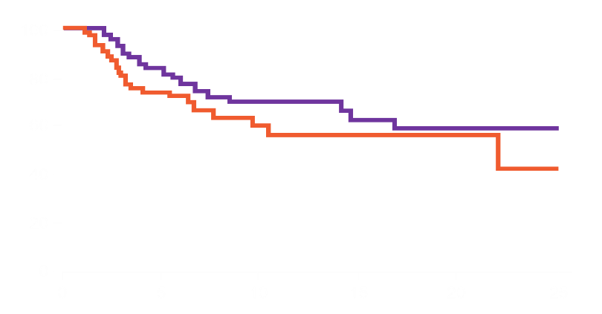
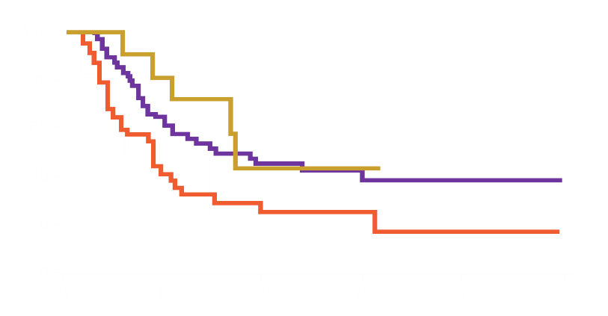
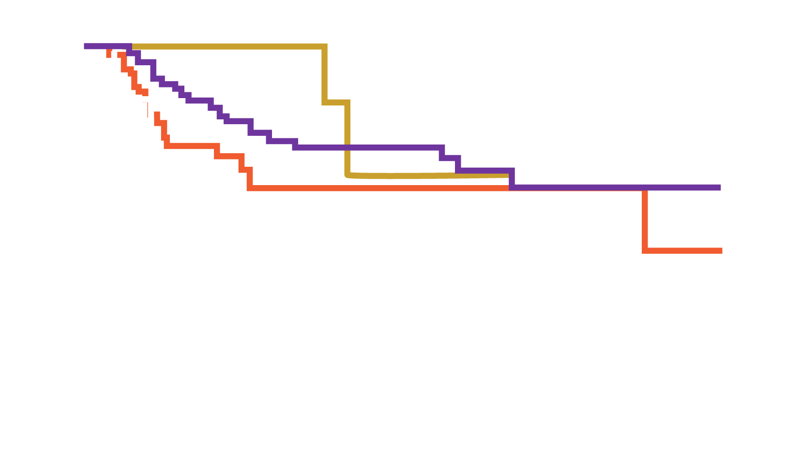
The impact of bridging therapy among patients with relapsed and refractory LBCL treated with commercially available axi-cel
PFS
OS
No BT (n=62)
BT (n=62)
Percent survival
Percent survival
1 year PFS 44 vs 29%
p=0.06
1 year OS 70 vs 56%
p=0.22
No BT (n=62)
ST bridging (n=45)
RT bridging (n=11)
CMT bridging (n=6)
Percent survival
Percent survival
Time (months)
Time (months)
Mod da Pinnix CC, et al. Blood Adv 2020; 4: 2871–2883

Slide 22
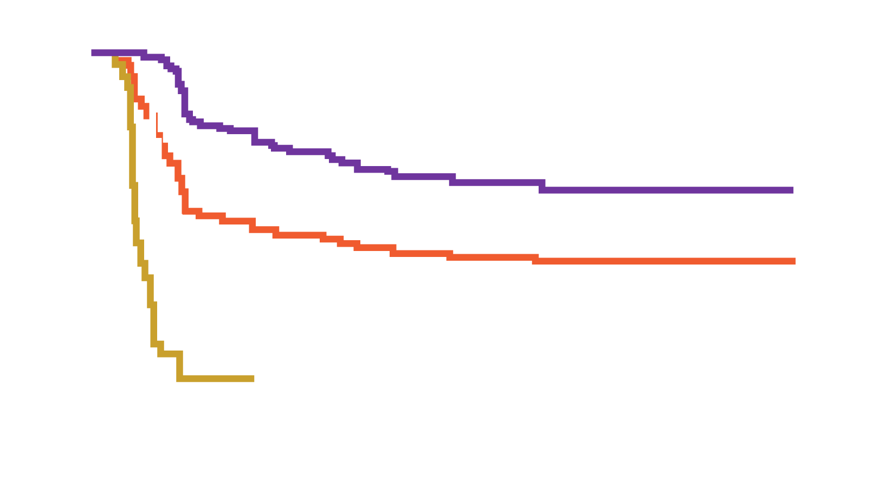
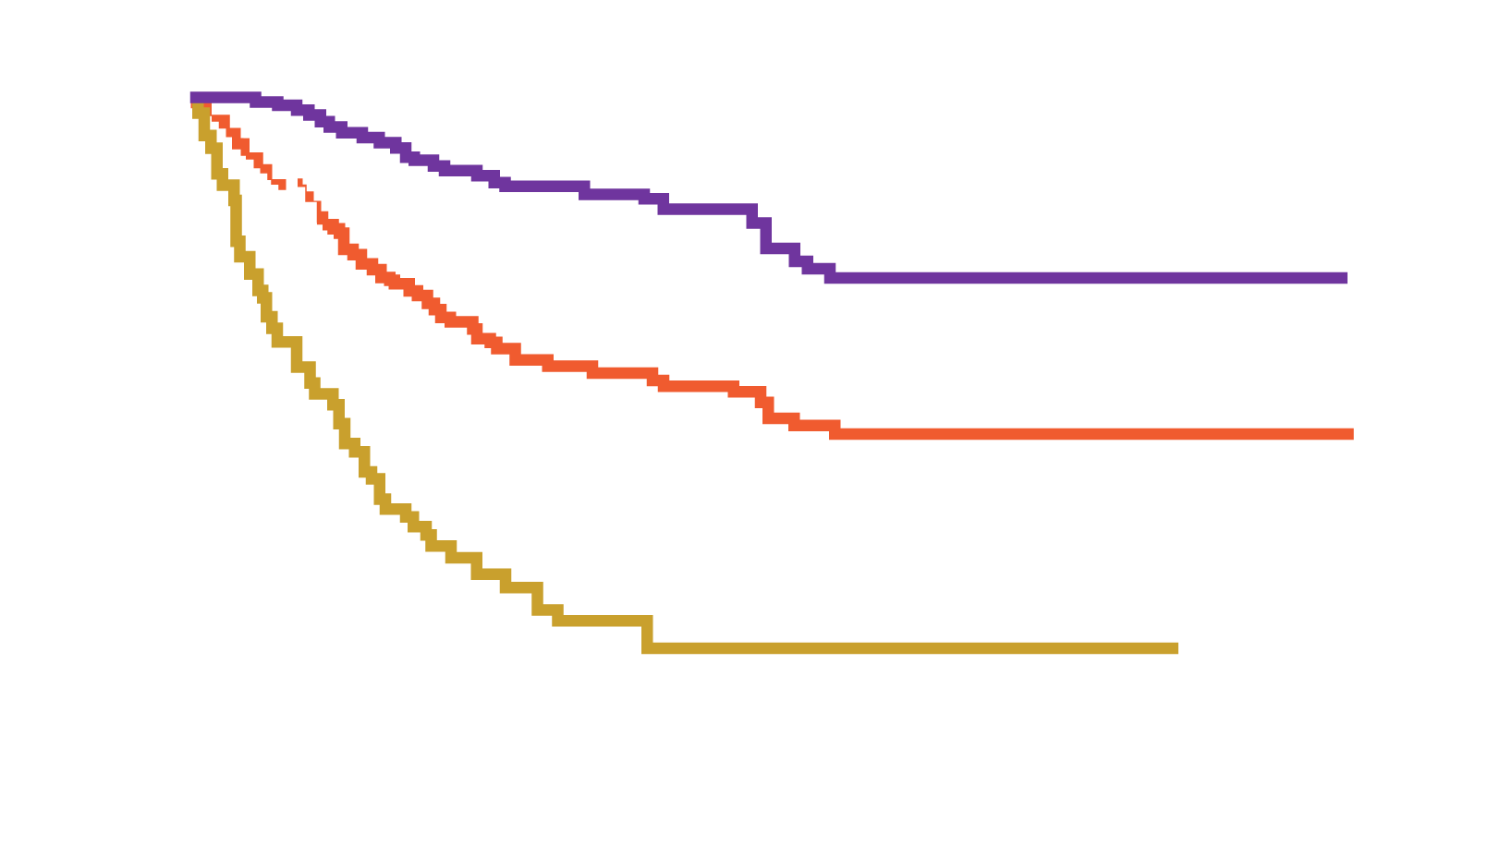
Partial remission / refractory-relapse to CAR-T
PFS median follow-up (95% CI): 12.3 (12.0–17.5) months
OS median follow-up (95% CI): 17.6 (13.5–18.0) months
CR – Median (95% CI): NR (NR–NR) months
Total – Median (95% CI): 6.8 (3.3–14.1) months
PR – Median (95% CI): 2.8 (2.1–3.0) months
SD/PD – Median (95% CI): 1.1 (1.0–1.6) months
CR – Median (95% CI): NR (NR–NR) months
Total – Median (95% CI): 21.2 (13.3–NR) months
PR – Median (95% CI): 9.0 (6.0–10.4) months
SD/PD – Median (95% CI): 5.1 (2.9–6.5) months
PFS probability (%)
OS probability (%)
Time (months)
Time (months)
6-Month PFS (95% CI), %
All patients | 51.4 (44.6–57.7)
Patients with BOR of CR | 76.1 (67.9–82.4)
12-Month PFS (95% CI), %
All patients | 44.1 (37.3–50.7)
Patients with BOR of CR | 65.1 (56.1–72.7)
6-Month OS (95% CI), %
All patients | 74.7 (68.9–79.6)
Patients with BOR of CR | 94.1 (88.6–97.0)
12-Month OS (95% CI), %
All patients | 57.9 (51.3–63.8)
Patients with BOR of CR | 85.5 (78.2–90.5)
Mod. da Abramson JS, et al. Blood 2019; 134 (Suppl_1): 241
BOR: best observed response; SD: stable disease; PD: progressive disease

Slide 23
Partial remission / refractory-relapse to CAR-T
Which options:
Allo-TMO
Bispecific
Anti-CD19
New drugs
Clinical trials

Slide 24
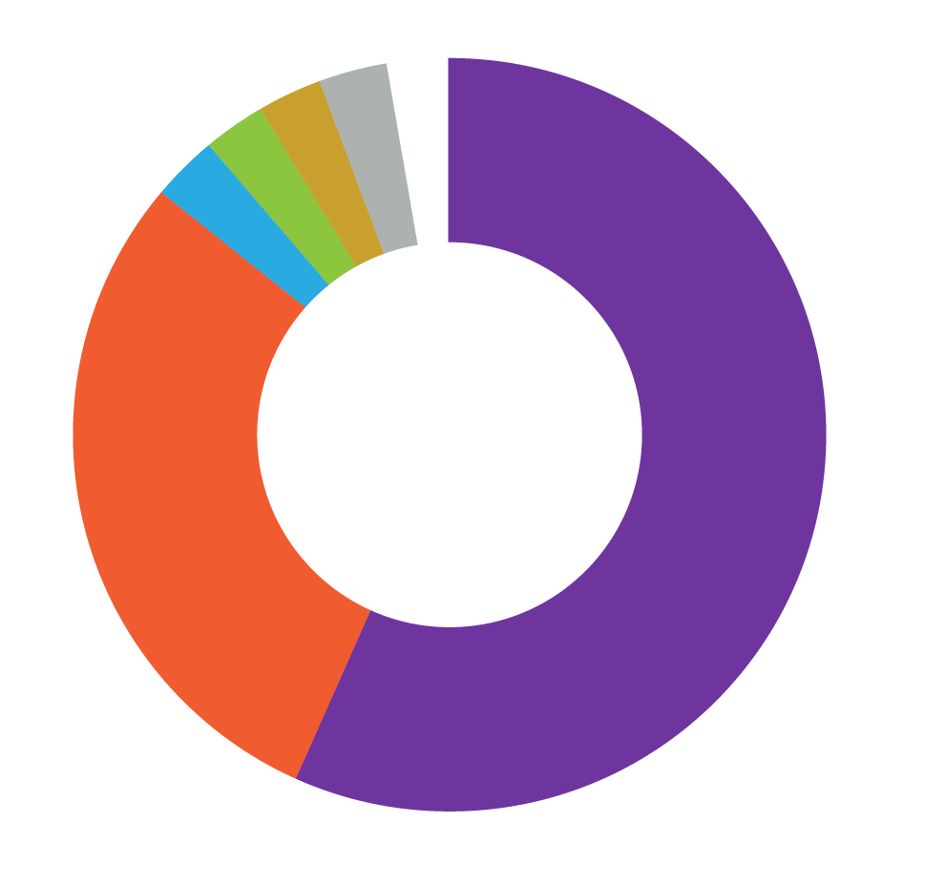
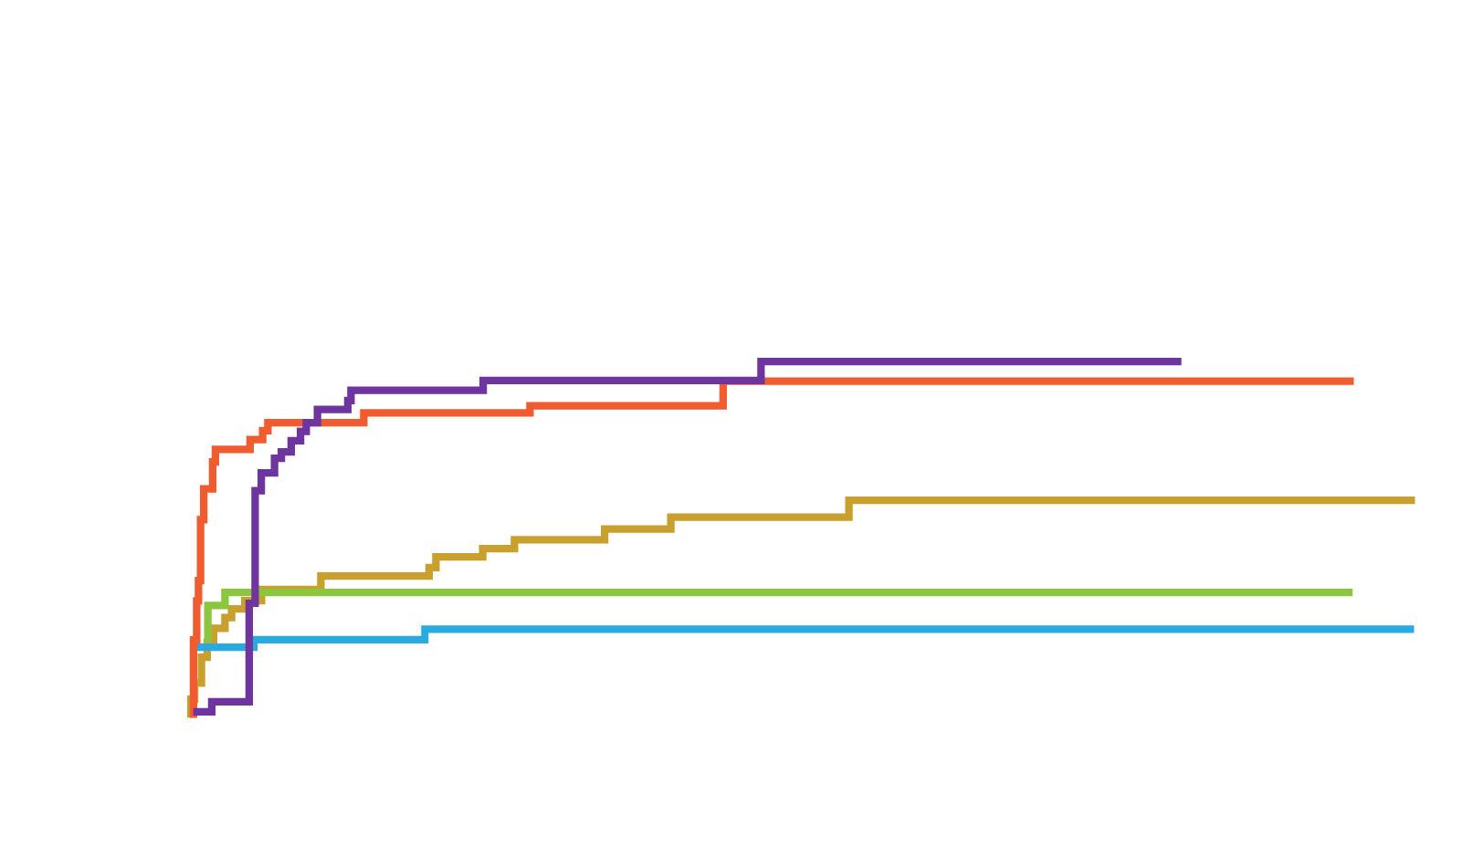
Open issues in CAR-T therapy: Toxicity
Cardiovascular 1
Hepatic 1
Infection 1
Hematologic
Metabolic
Infection
Neurologic
Cardiovascular
Pulmunary
Neurology 1
Pulmonary 1
Cumulative incidence
Metabolic
10
Hematologic
20
Months
A. Cumulative incidence of toxicities grade ≥3 with an incidence of >10% as stratified
by organ systems
B. Severe toxicities grade 4 and grade 5 as stratified by organ system
Mod. da Wudhikam K, et al. Blood Adv 2020; 4: 3024–3033

Slide 25
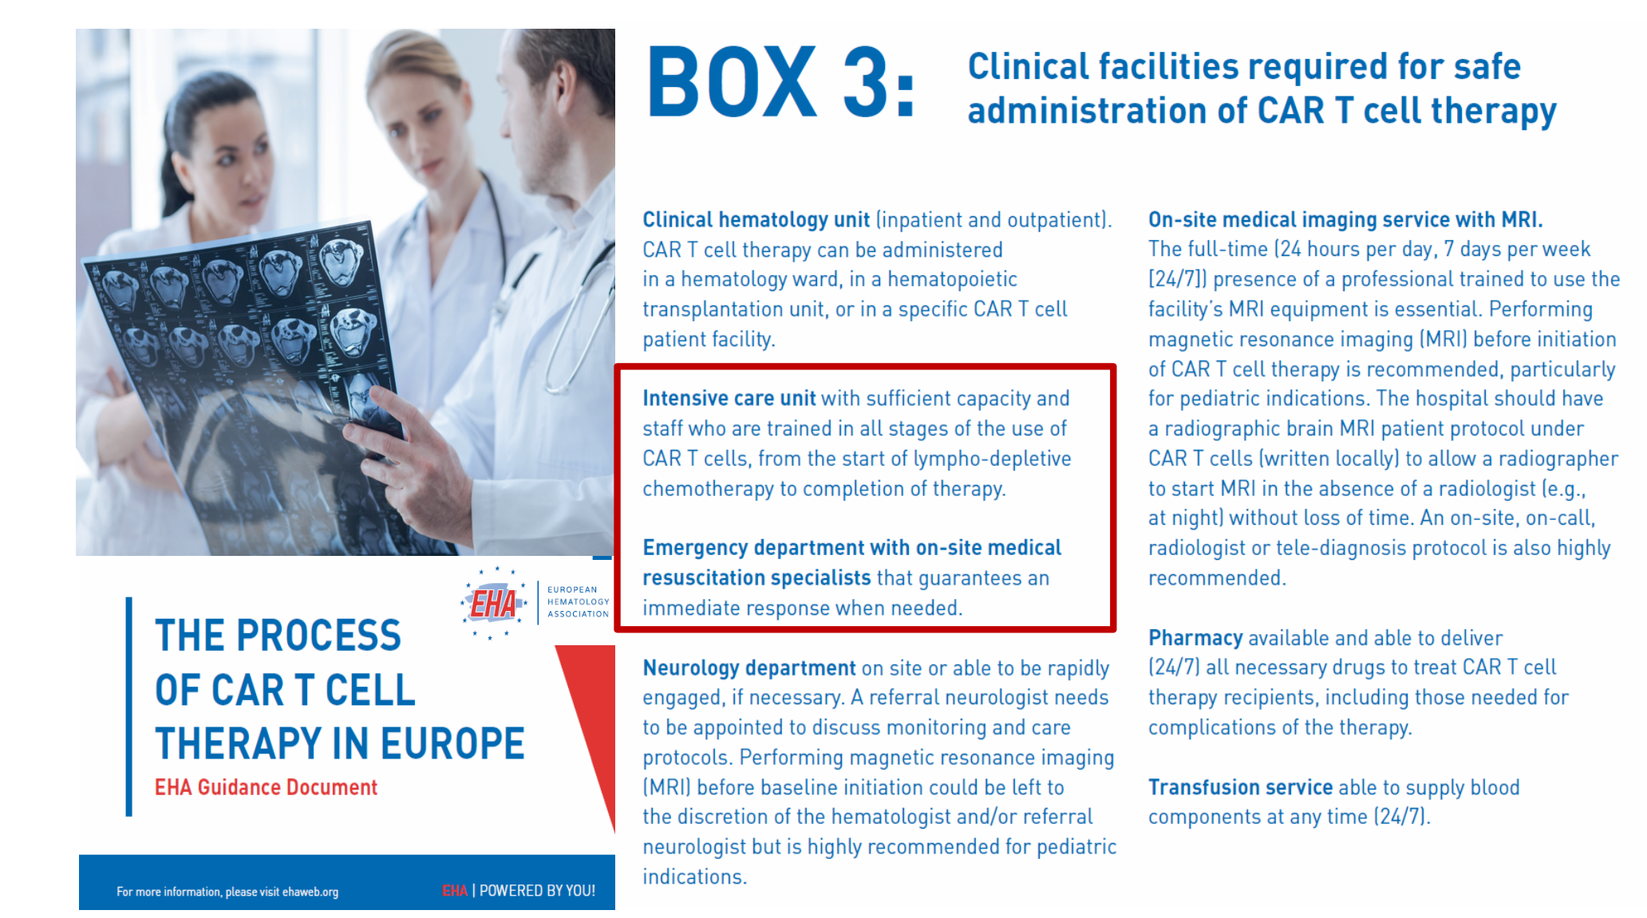
CAR-T clinical facilities
EHA Guidance Document 2019, Hemashere 2019

Slide 26
Biological markers: Multivariate analysesª for DoR and PFS in JULIET
Multivariate Cox regression model for DoR (N=51)
Parameter |  | Hazard ratio | 95% CI | p value
Transduction efficiency (%CAR+ T cells) |  | 2.33 | 0.45–12.1 | 0.31
CAR+CD4+ Effector memory T cells (10E8) log |  | 1.24 | 0.31–4.95 | 0.76
CAR+CD8+ Effector memory T cells (10E8) log |  | 0.73 | 0.27–1.94 | 0.53
CAR-negative T cells (10E8) log |  | 1.30 | 0.15–11.2 | 0.81
CAR+CD8 T cells (10E8) log |  | 1.29 | 0.44–3.77 | 0.64
CAR+CD4 T cells (10E8) log |  | 0.44 | 0.06–3.25 | 0.42
0.01
1
100
Multivariate Cox regression model for PFS (N=95)
Parameter |  | Hazard ratio | 95% CI | p value
Baseline LDH, log |  | 1.22 | 0.93–1.60 | 0.14
Baseline CRP, log |  | 1.05 | 0.93–1.20 | 0.42
Total viable T cells (10E8) log |  | 1.03 | 0.67–1.58 | 0.88
Transduction efficiency (%CAR+ T cells) |  | 1.16 | 0.86–1.56 | 0.34
Total number of CAR+CD4+2B4+ T cells (10E8) log |  | 0.86 | 0.70–1.06 | 0.16
Total number of CAR+CD4+ effector T cells (10E8) log |  | 0.90 | 0.75–1.08 | 0.27
0.01
1
100
33 CAR+ T cell variables and 12 product release attributes were examined in the univariate Cox regression for DoR and PFS.
Significant variables were further evaluated in the multivariate Cox regression that were adjusted for cell count or key baseline characteristics (LDH, CRP or tumor volume)
Mod. da Bachanova V, et al. Blood 2019; 134 (Suppl_1): 242
ªMultivariate analyses were adjuested for LDH, CRP, and tumor volume; CRP: C-reactive proteine

Slide 27
3
Relapse after first line:
BELINDA and TRANSFORM trials

Slide 28
BELINDA trial
Inclusion criteria
Histologically proven DLBCL NOS (de novo or transformed indolent lymphoma), DHL/THL, FL3B, PMBCL or THRBCL.
Refractory to (SD, PD, PR or CR with relapse before 3 months) or relapsed (CR with relapse on or after 3 months) within 12 months from CD20 antibody and anthracycline containing first line therapy
ECOG ≤1
Eligible to transplant
Arm A: CTL019 (n=159)
Safety and efficacy follow-up
Week 6 for treatment decision
Week 12±1week for disease assessment
q3m to M12
q6m to M24
Annual to M60
M
SCREENING
ENROLLMENT
Bridging chemo as needed
6 wks PET/CT
12 wks PET/CT
R
n=318 randomized 1:1, stratification by region (NA vs ROW), refractory/relapsed <6 months vs 6–12 months, IPI (<2 vs ≥2)
APH
CR
Optional 3rd cycle of salvage + HDCT + ASCT
SD/PD
by BIRC
Crossover allowed, if no response at 12 weeks by BIRC until 1 year post ASCT
If the patient responds to 1 or more cycles of SOC2, every attempt should be made to bring the patient to ASCT
Arm B: SOC
(n=159)
PR
SOC 1–6 wk
SD/PD
by BIRC
SOC 2
CR/PR
Δ Therapy
required
M
Start CTL019 manufacture if PD/SD at week 6 (n~107)
1st endpoint EFS
EFS event:
SD/PD by BIRC at/after week 12±1 week
Death at any time
Week 6
Week 12
ASCT: autologous hematopoietic stem cell transplant; BIRC: blinded independent review committee; HDCT: high dose chemotherapy;
M: manufacturing; CR: complete response; PR: partial response; SD: stable disease; PD: progressive disease;
APH: apheresis; IPI: International Prognostic index (1993); SOC: standard of care
ClinicalTrials.gov Identifier: NCT03570892

Slide 29
BELINDA BULLETIN: CTL019H2301 newsletter
N° | Investigator | Pazienti screnati | Pazienti randomizzati | Pazienti screening failure
2300 | CORRADINI Paolo | 1 | 1 | 0
2301 | SICA Simona | 2 | 1 | 1
2302 | SANTORO Armando | 9 | 6 | 3

Slide 30
TRANSFORM trial
Key eligibility
Age ≥18 and ≤75 years
Aggressive NHL (DLBCL NOS [de novo or transformed indolent NHL], DHL/THL, FL3B, PMBCL, THRBCL)
→ PET-positive per Lugano criteria, histologically confirmed
Refractory or relapsed within 12 months from anthracycline/anti-CD20 containing 1st line
ECOG ≤1
Eligible to transplant
Futility analysis
Interim analysis
Primary endpoint
EFS
Key secondary endpoints
CRR
PFS
OS
Main secondary endpoints
DoR
ORR
PFS-2
HRQoL
Arm A (SOC + HDCT & HSCT)
15 evaluable subjects in each arm with 1st response assessment
60% of
EFS events met (approx. 71 events)
Open label, randomization (1:1)
Stratification
Refractory vs relapsed
sAAIPI: 0/1 vs 2/3
Arm B (JCAR017)
Arm A: SOC defined as R-DHAP, R-ICE or R.GDP followed by HDCT (BEAM) and HSCT
Arm B: JCAR017 T cells 1x10⁸
Region/country
US + Europe + Japan
ClinicalTrials.gov Identifier: NCT01950819

Slide 31
4
CAR-T in mantle cell lymphoma

Slide 32
KTE-X19 CAR-T cell in MCL
Baseline characteristics of all 68 patients
Median age (range) | 65 (38–79)
Intermediate or high risk MIPI - n (%) | 38 (56)
Blastoid or pleomorphic morphologic characteristics of MCL - n (%) | 21 (31)
Median n of previous therapies | 3
Previous auto-SCT - n (%) | 55 (81)
Previous BTK inhibitor therapy - n (%) Ibrutinib Acalabrutinib Both | 68 (100) 58 (85) 16 (24) 6 (9)
Relapse after auto-SCT- n (%) Refractory to most recent previous therapy – n (%) | 29 (43) 27 (40)
Inclusion criteria:
Previous therapy: chemotherapy and anti-CD20 monoclonal antibody, AND BTK inhibitor therapy
MCL: mantle cell lymphoma; MIPI: Mantle-Cell Lymphoma International Prognostic Index
Mod. da Wang M, et al. N Engl J Med 2020; 382: 1331–1342

Slide 33

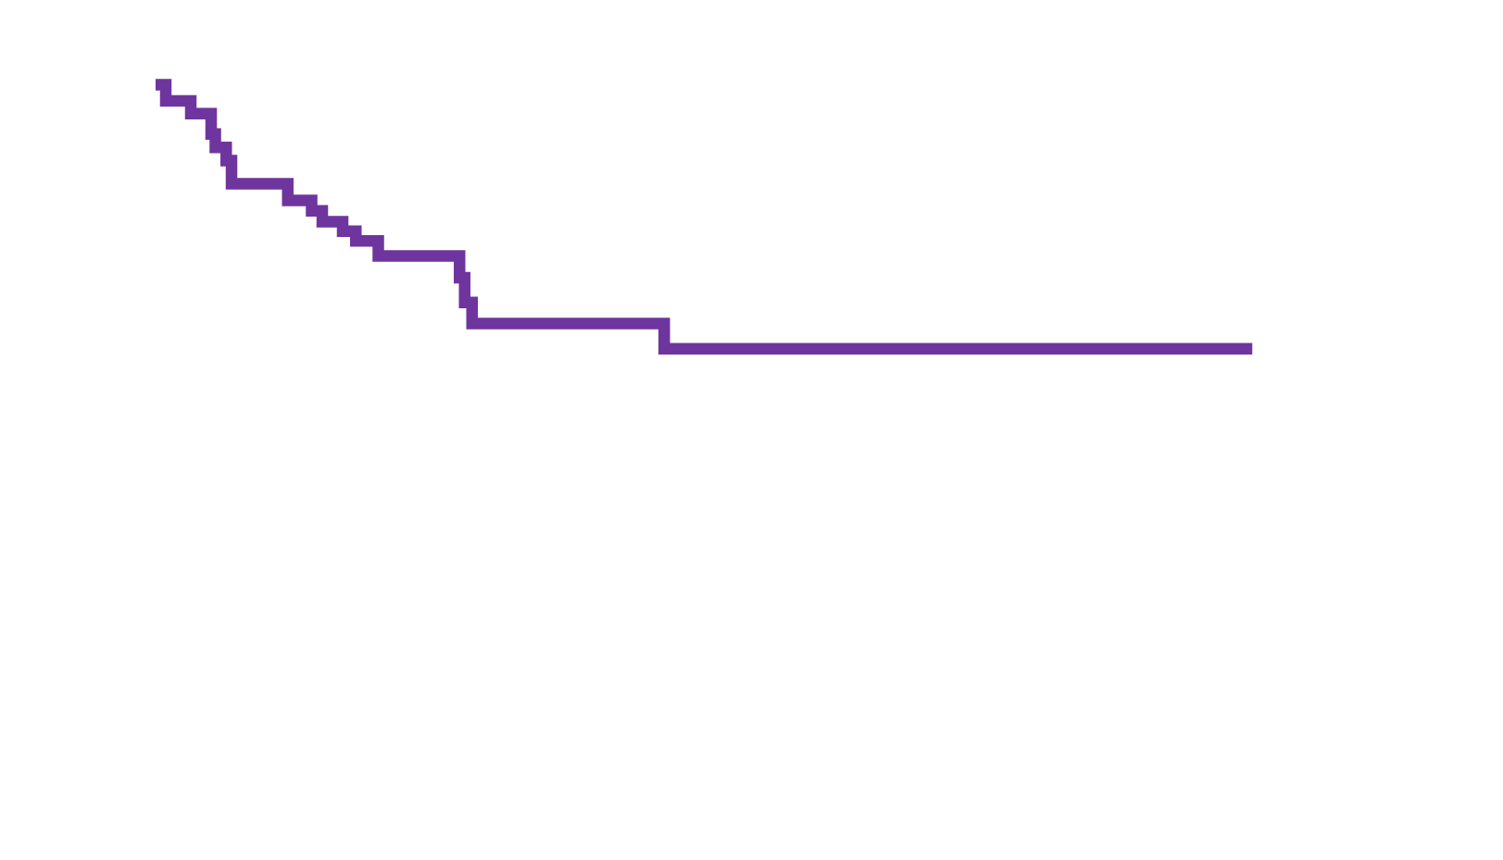
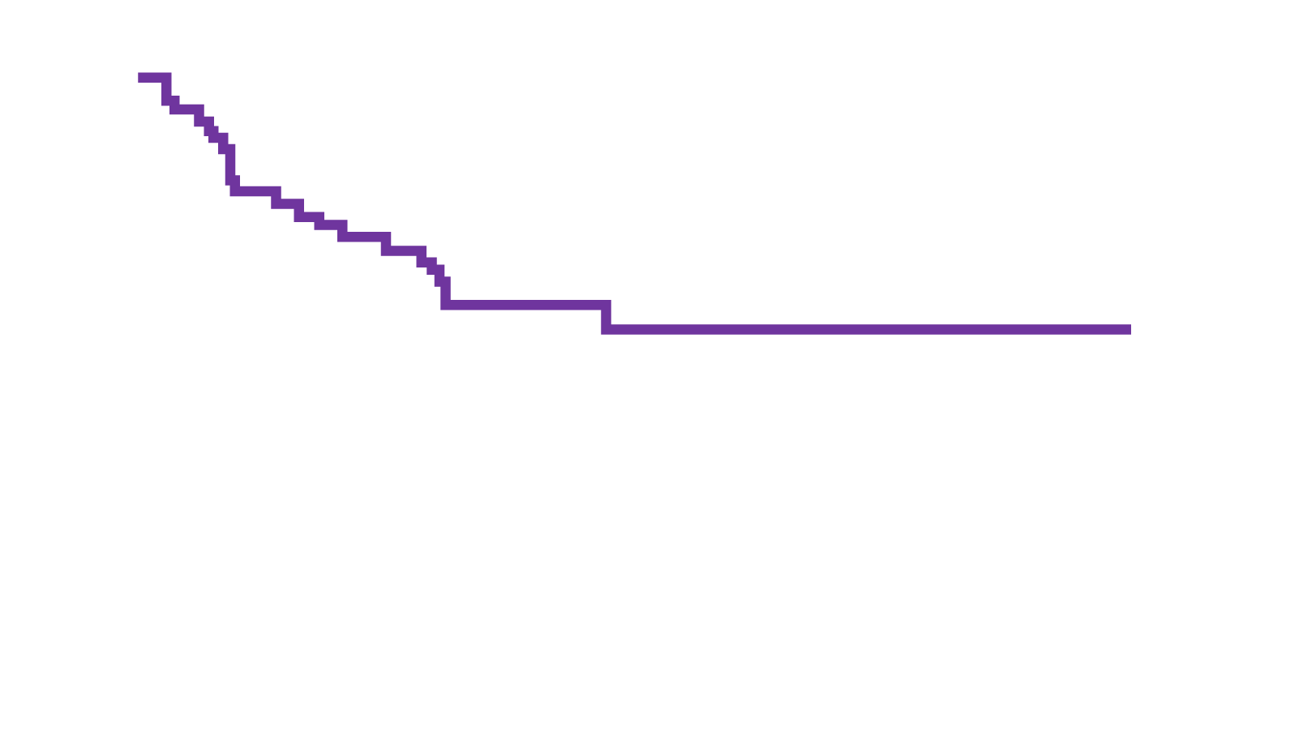
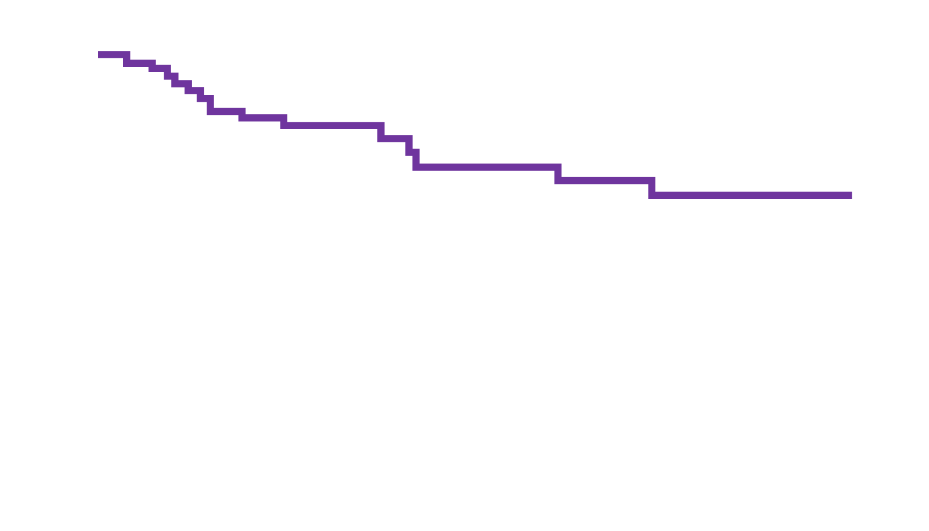
KTE-X19 CAR T-Cell in MCL
56 (93)
Best response
DoR
40 (67)
CR
PR
Percent of patients
Percent of patients with response
16 (27)
2 (3)
2 (3)
Median, NR (95% CI, 8.6–NE)
OR
SD
PD
Months
PFS
OS
Percent of patients without progression
Percent of patients alive
Median, NR (95% CI 9.2–NE)
Median, NR (95% CI, 24.0–NE)
Months
Months
Mod. da Wang M, et al. N Engl J Med 2020; 382: 1331–1342
OR: objective response; SD: stable disease;: PD; progressive disease; CR: cpmplete response; PR: partial response

Slide 34
5
CAR-T in follicular lymphoma

Slide 35
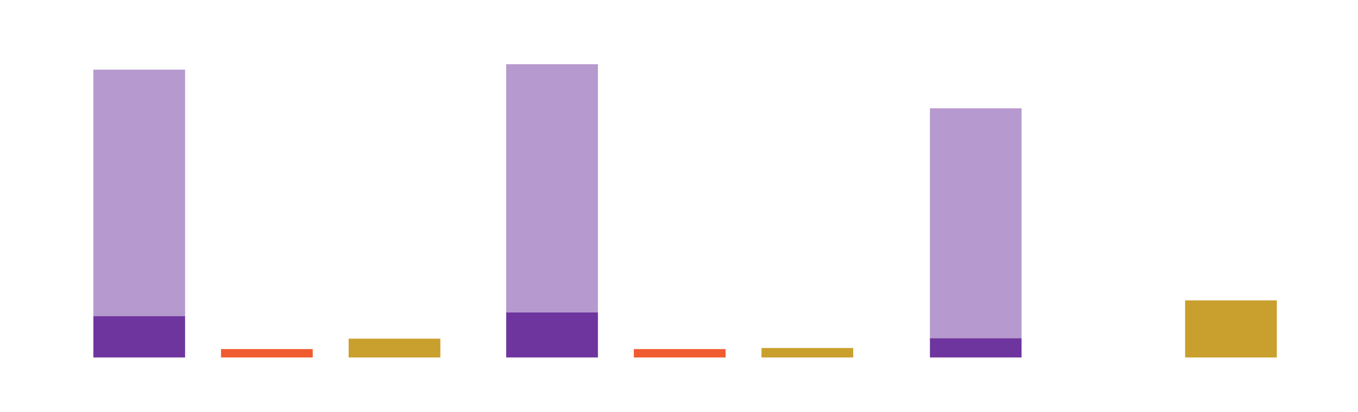
ZUMA-5: Study design
Key eligibility criteria
R/R FL (Grade 1 – Grade 3a) or MZL (nodal or extranodal)
≥ 2prior lines of therapy – must have included an anti-CD20 mAb combined with an alkylating agent
Conditioning regimen
Fludarabine 30 mg/m² IV and cyclophosphamide 500 mg/m² IV in days -5, -4, -3
Axi-cel
2x10⁶ CAR+ cells/kg
Primary endpoint
ORR (IRRC-assessed per
the Lugano classification)
Key secondary endpoints
CR rate (IRRC-assessed)
DoR, PFS, OS
AEs
CAR T cell and cytokine levels
Phase 2
(N~160 planned for enrollment)
R/R
iNHL
FL: n~125
(with n ≥ 80 evaluable for efficacy)
MZL: n~35
All patients (n=96)
FL (n=80)
MZL (n=16)
93% ORR
95% ORR
CR
PR
SD
ND
81% ORR
Best objective response, %
80% CR
(n=77)
81% CR
(n=65)
75% CR
(n=12)
19%
(n=3)
2%
(n=2)
5%
(n=5)
3%
(n=2)
3%
(n=2)
13% PR
(n=12)
14% PR
(n=11)
6% PR
(n=1)
0
ORR
SD
ND
ORR
SD
ND
ORR
SD
ND
Mod. da Jacobsen CA, et al. J Clin Oncol 2020: 38 (Suppl_15): 8008

Slide 36
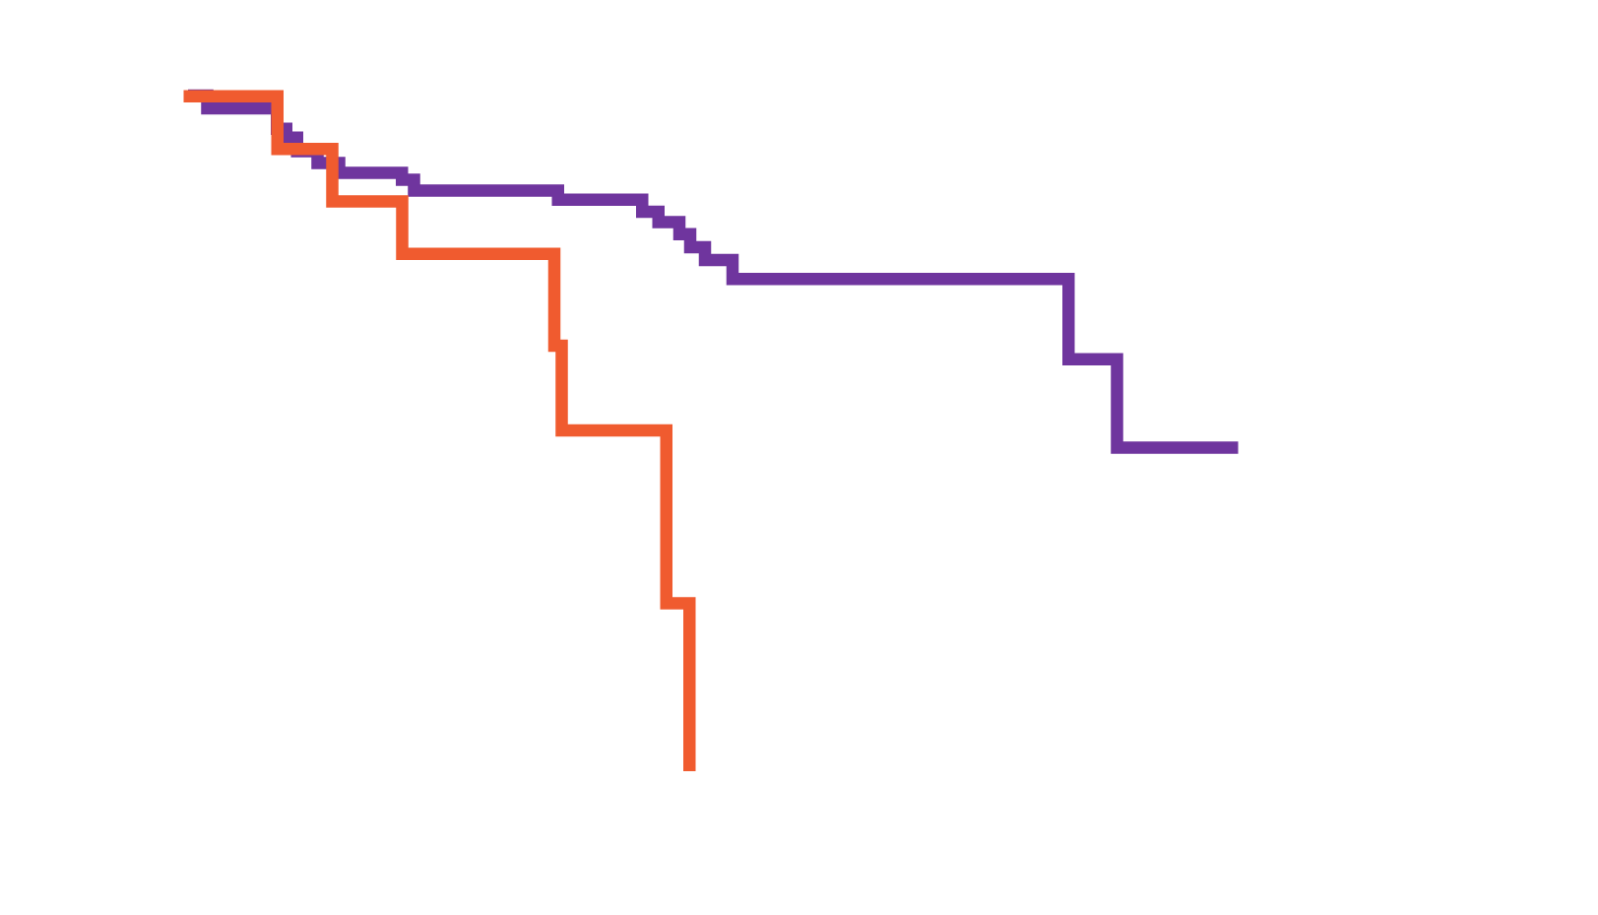
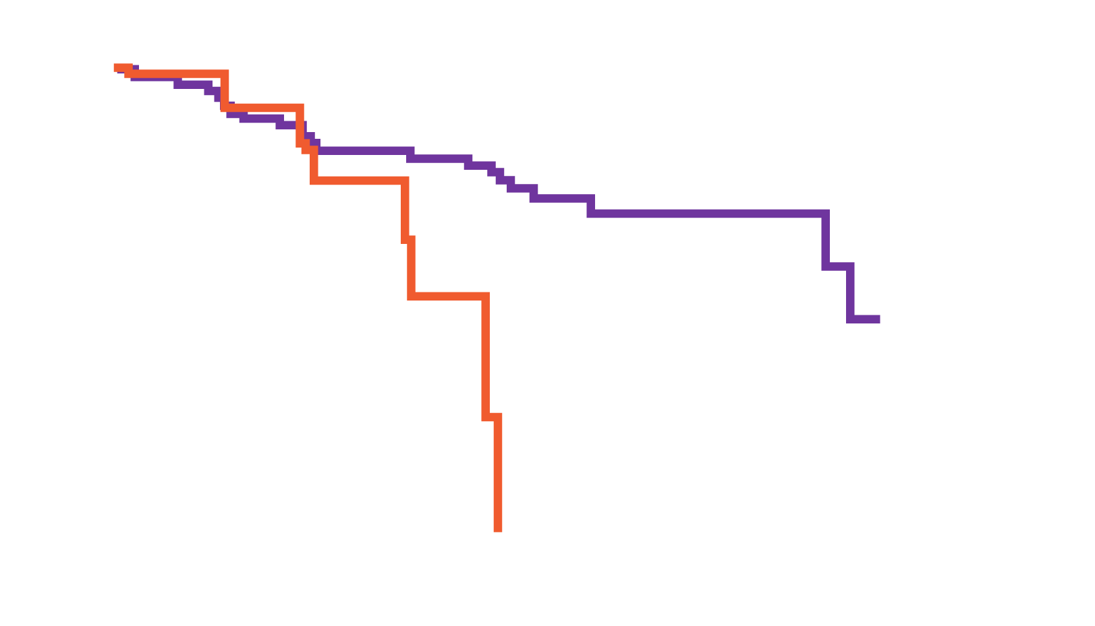
ZUMA-5: Results
DoR
PFS
 | FL (n=80) | MZL (n=16)
Median follow-up (range), months | 16.0 (10.1–28.8) | 11.1 (1.9–23.9)
Median DoR (95% CI), months | 20.8 (19.7–NE) | 10.6 (4.6–11.1)
 | FL (n=80) | MZL (n=16)
Median DoR (95% CI), months | 23.5 (22.8–NE) | 11.8 (6.0–12.0)
DoR (%)
PFS (%)
FL
MZL
FL
MZL
Time (months)
Time (months)
Median FU: 15.3 months; Median DoR: 20.8 months
Median FU: 15.3 months; Median PFS: 23.5 months (95% CI 22.8–NE)
Median OS not reached
Mod. da Jacobsen CA, et al. J Clin Oncol 2020: 38 (Suppl_15): 8008

Slide 37
6
Future perspective:
NK, tandem CD19+CD20, allo-CAR-T

Slide 38
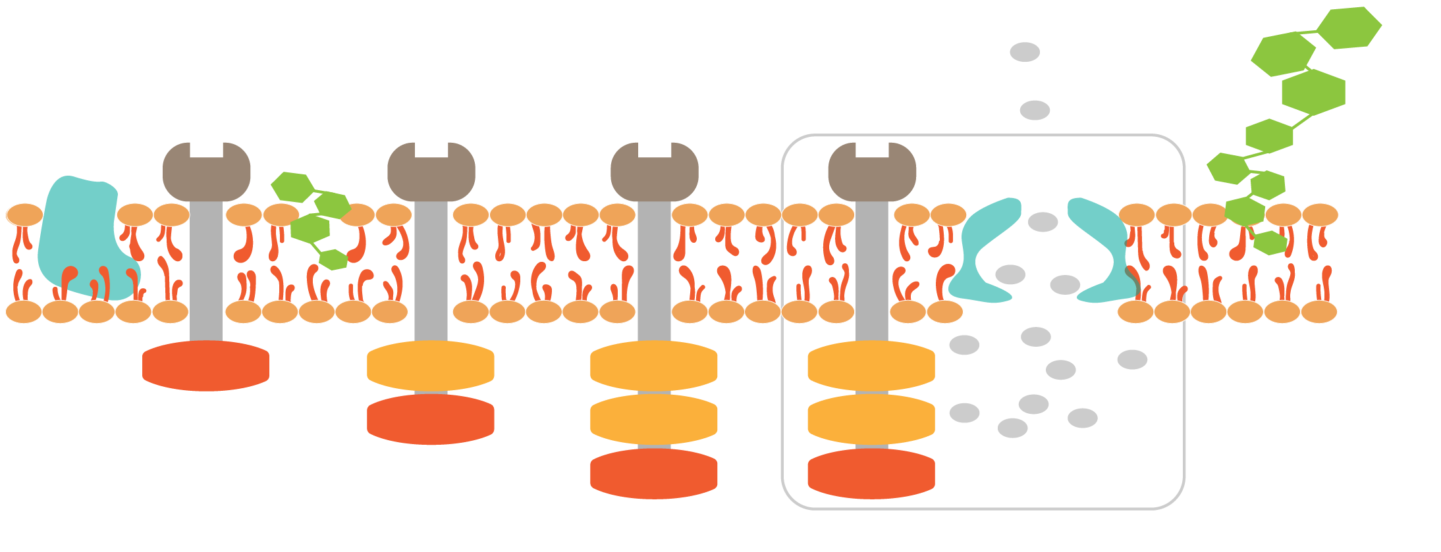

Four generation of CAR-T cells
1G
2G
3G
4G
Phospholipid
Glycogen
Signalin chain: CD3 ζ
Cytokine
Protein
Target recognition: scFv
Co-stimulator: CD28/CD137
4G contains vectors encoding CAR and specific reactive promotor
which could produce and secrete transgenic cytokines, such as IL-12
Mod. da Zhao J, et al. Ann Hematol 2020; 99: 1681–1699
IL-12: interleukin-12; scFv: single chain fragment variable

Slide 39
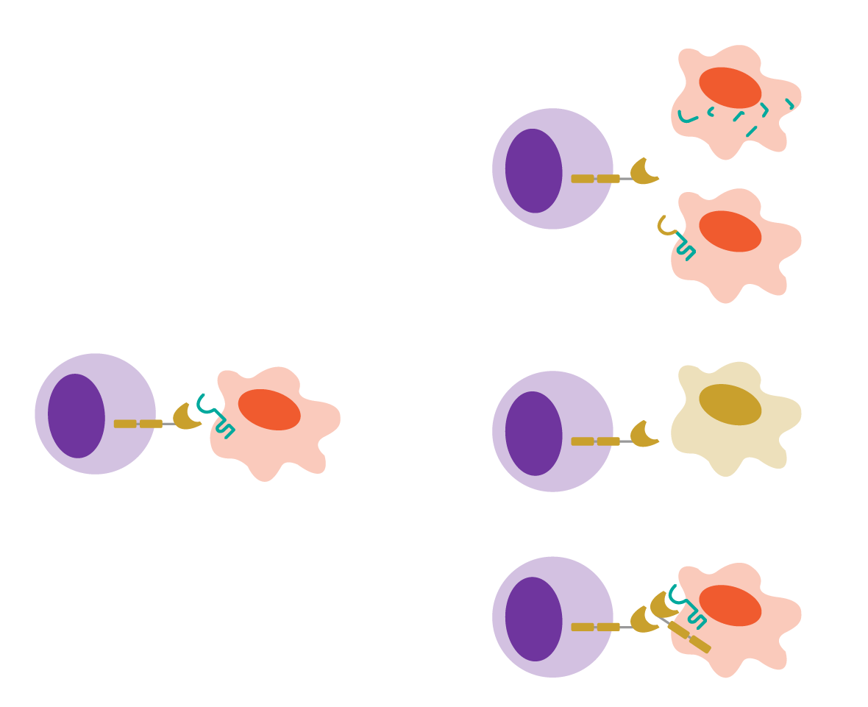
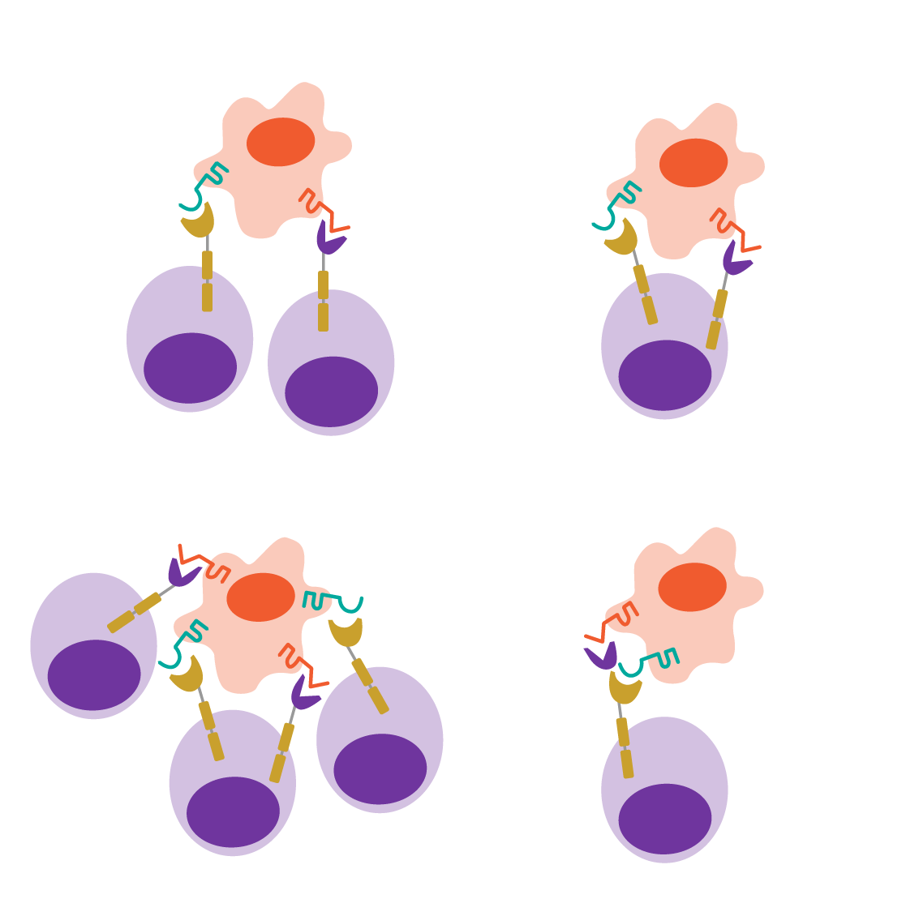
Targeting multiple molecules to overcome limitation of antigen loss in CAR-T cell therapies
A. Receptor genetic mutations
A. Coadministration
B. Bicistronic
i.
Tumor
CD19
CD20
ii.
CD19
CAR-T cell
CD20
CAR-T cell
B. Cell lineage change
C. Cotransduction
D. Tandem
Anti-CD19
CAR-T cell
CD19+
tumor
C. Epitope masking
Mod. da Shah NN, et al. Front Oncol 2019; 9: 146

Slide 40
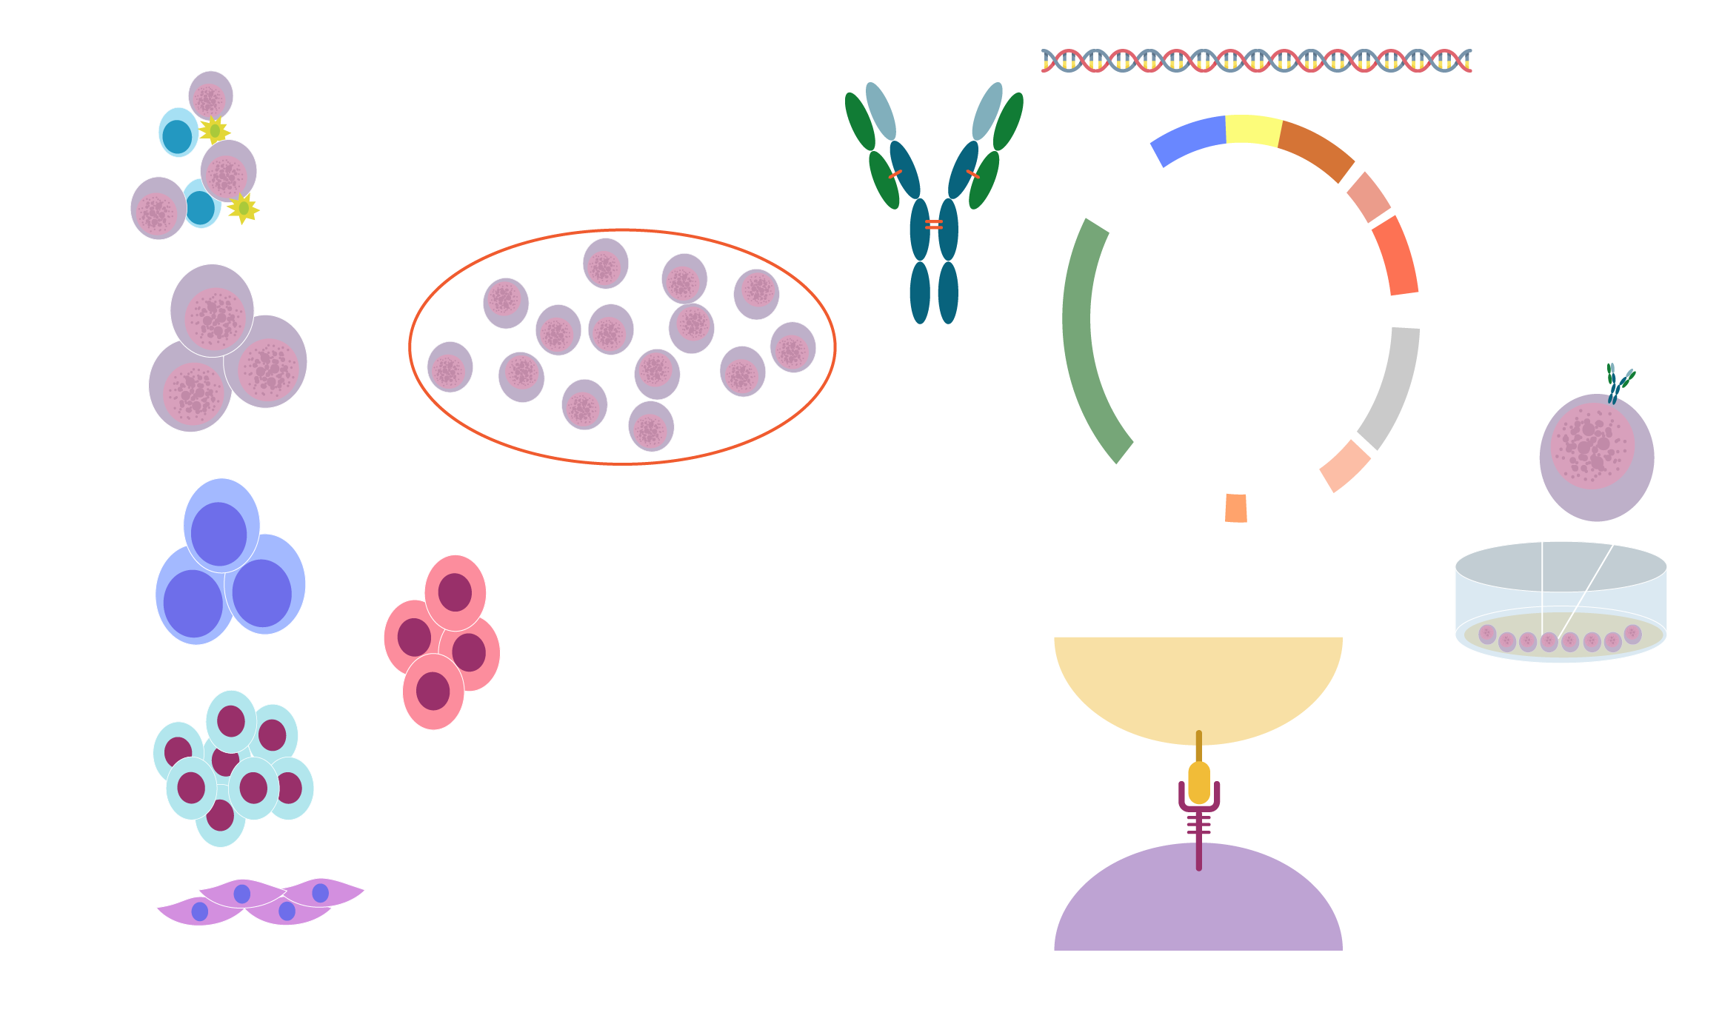
Procedures for clinical application of CAR-NK adoptive cell therapy (ACT)
CAR
MCS
PBMC
PCMV
Sorting
f1ori
SV40ori
Irradiation
PCMV-CAR
NK
cells lines
Amp^{r}
CAR structure
Neomycin
NK
SV40pA
Induction
Ori
UCB
Differentiation
Tumor
Tumor
antigen
CD34+
cells
CAR-NK
Feeders
hESC
CAR
hiPSC
NK
Co-stimulatory
domain
Infuse NK into patient
NK: natural killer; UCB: umbilical cord blood; ESC: embryonic stem cells; iPSC: induced pluripotent stem cells; PCMV: porcine Cytomegalovirus
Mod. da Wang W, et al. Cancer Lett 2020; 472: 175–180

Slide 41
Highlights
Targeted lysis of CAR-NK is based on CAR and receptor dependent mechanisms
Achievements of CAR-NK are described in detail in pre-clinical and clinical studies
Introducing IL-15, ICR and suicide genes into CAR-NK enhance its safety and efficacy
Advances of CAR-NK will lead tumor immunotherapy into the era of precision medicine
Target | Tumors | NK source | CAR structure | Stage | NCT
CD7 | Lymphoma, leukemia | NK-92 | CD28+4-1BB+CD3ζ | I/II | NCT02742727
CD19 | Lymphoma, leukemia | NK-92 | CD28+4-1BB+CD3ζ | I/II | NCT02892695
CD33 | AML | NK-92 | CD28+4-1BB+CD3ζ | I/II (complete) | NCT02944162
MUC1 | Solid tumors | NK-92 | Unknown | I/II | NCT02839954
NR | NSCLC | NK-92 | Unknown | I | NCT03656705
HER2 | GBM | NK-92 | CAR5.28.z (HER2.taNK) | I | NCT03383978
CD19 | B-ALL | PB-NK | CD8α_{TM}+4-1BB+CD3ζ | II | NCT01974479
CD19 | B-ALL | PB-NK | CD8α_{TM}+4-1BB+CD3ζ | I (complete) | NCT00995137
CD19 | B-lymphoma | UCB-NK | CD28+CD3ζ +iCasp9+IL-15 | I/II | NCT03056339
AML: acute myeloid leukemia; ICR: inverted cytokine receptor
Mod. da Wang W, et al. Cancer Lett 2020; 472: 175–180

Slide 42
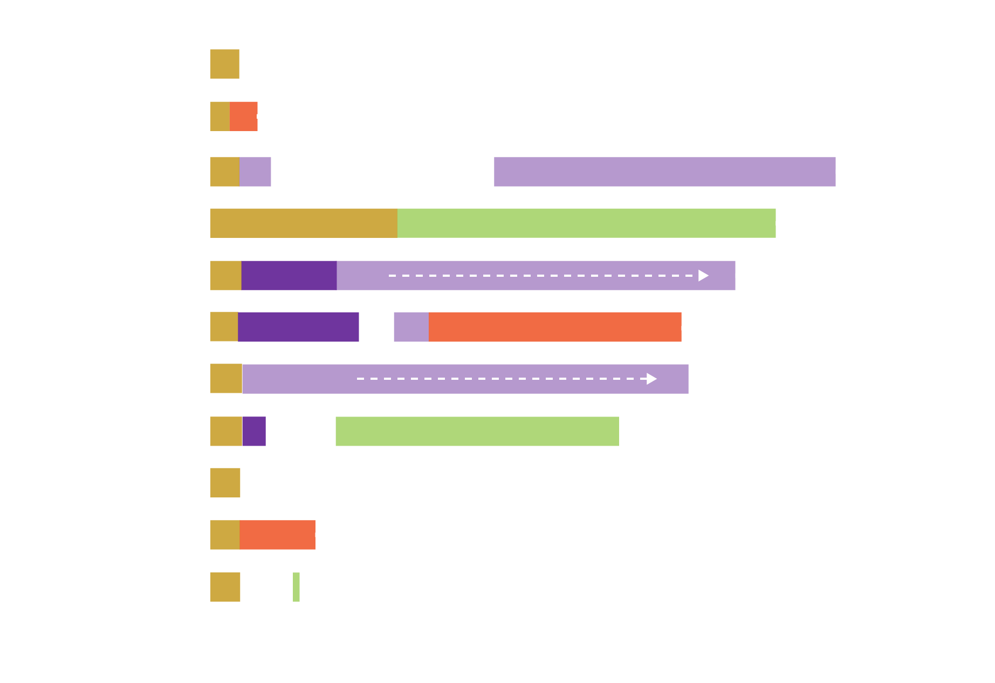
Conclusions
Active disease
PR
CR, MRD+ (BM)
CR, MRD- (BM)
HSCT
Relapse or progression
Lost to follow-up
On follow-up
Died
Dose level 1,
1x10⁵ cells/kg
Rituximab x4
Among 11 patients with
R/R CD19-positive cancers,
a majority had a response
to treatment with CAR-NK
cells without development
of major toxic effects
Dose level 2,
1x10⁶ cells/kg
Venetoclax
Patient number and dose level
Lenalidomide
Dose level 3,
1x10⁷ cells/kg
Months since infusion of CAR-NK cells
Mod. da Liu E, et al. N Engl J Med 2020; 382: 545–553

Slide 43
CAR-T in Humanitas
35 NHL
6 PMBCL
28 DLBCL
1 ALL
SPERIMENTAL CAR-T PROGRAM
9
ELIGIBLE
24 (68%)
NOT ELIGIBLE
11
APHERESIZED
n=24 (100%)
NOT INFUSED
2 protocol driven
1 rapidly progressive disease
WAITING FOR INFUSION
3
INFUSED
18
TODAY

Slide 44
Work in progress
Ongoing (sponsored):
BELINDA trial (top enroller in Italy)
TRANSFORM trial
Allogeneic NK CAR-T in hematologic/solid tumors
CD30+ CAR-T in Hodgkin
Ongoing (academic):
Gut microbioma and CAR-T
(with Maria Rescigno)
Retreatment in DLBCL responsive to first CAR-T
Retreatment in follicular lymphoma

