Slide 1
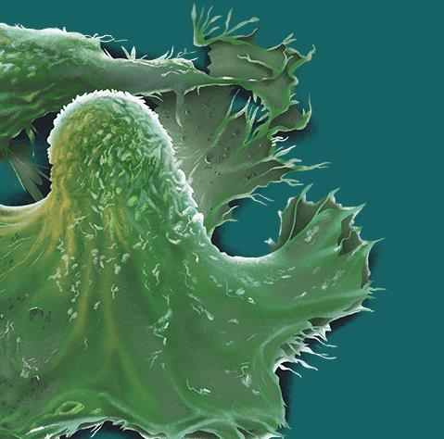
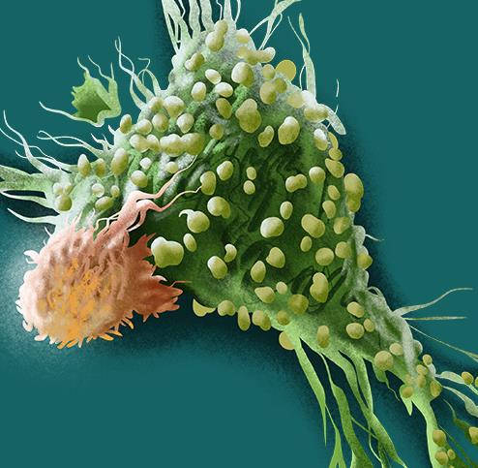
Basi biologiche delle tossicità da CAR-T
Matteo G Carrabba
CAR Team Clinical Leader
05/2021

Slide 2
Chimeric antigen receptors
Key advantages
  Independency from MHC restriction
  Targeting of proteins, sugars, lipids
  Multiple effector mechanisms
  Living drugs (expansion, memory)

Slide 3
CAR generations
Natural T cells require costimulation to fully activate
cytokines, expansion, persistence

Slide 4
CD19 CAR-T in B-cell tumors
Cancer | Site | n | CAR | CR (%) | Reference
B-ALL | NCI | 21 | 28z | 60 | Lee, Lancet 2015
B-ALL | MSKCC | 53 | 28z | 67 | Park, NEJM 2018
B-ALL | FHCC | 30 | BBz | 93 | Turtle, JCI 2016
B-ALL | Multiple ELIANA | 75 | BBz | 81 | Maude, NEJM 2018
NHL | Multiple ZUMA-1 | 101 | 28z | 54 | Neelapu, NEJM 2018
NHL | Multiple JULIET | 93 | BBz | 40 | Schuster, NEJM 2019
NHL | FHCC | 32 | BBz | 33 | Turtle, STM 2016
CLL | UPenn | 14 | BBz | 29 | Porter, STM 2015
CLL | FHCC | 24 | BBz | 17 | Turtle, JCO 2017

Slide 5
CD19 CAR-T products for lymphoma
 | Axi-cel | Tisa-cel | Liso-cel | Brexu-cel
Institution | NCI/MDACC | UPenn | SCH/FHCRC | MDACC
Sponsor | Kite-Gilead | Novartis | Juno-BMS | Kite-Gilead
Trial | ZUMA-1 | JULIET | TRANSCEND | ZUMA-2
FDA approval | 2017 (Yescarta®) | 2018 (Kymriah®) | 2021 (Breyanzi®) | 2020 (Tecartus®)
Tumor | DLBCL, t-FL, PMBCL | DLBCL, t-FL | DLBCL, t-FL | MCL
CAR design | CD28-CD3z | 41BB-CD3z | 41BB-CD3z | CD28-CD3z
Reference | Locke, Lancet 2019 | Schuster, NEJM 2019 | Abramson, Lancet 2020 | Wang, NEJM 2020
Strong interaction between academia and industries

Slide 6
Main CAR-related toxicities
On-target off-tumor toxicity
Damage of healthy tissues expressing the target antigen
Quite relevant: tumor-specific antigens are rare
Severity depends on how vital, accessible and widespread the targeted tissue is (CD19 → B-cell aplasia → Immunoglobulin Replacement Therapy)
Particularly dangerous for solid tumors

Slide 7
Main CAR-related toxicities
Cytokine release syndrome
Cancer | Site | CAR | Severe CRS (%) | Reference
B-ALL | NCI | 28z | 29 | Lee, Lancet 2015
B-ALL | MSKCC | 28z | 26 | Park, NEJM 2018
B-ALL | FHCC | BBz | 23 | Turtle, JCI 2016
B-ALL | Multiple ELIANA | BBz | 47 | Maude, NEJM 2018
NHL | Multiple ZUMA-1 | 28z | 13 | Neelapu, NEJM 2018
NHL | Multiple JULIET | BBz | 22 | Schuster, NEJM 2019
NHL | FHCC | BBz | 13 | Turtle, STM 2016
CLL | UPenn | BBz | 43 | Porter, STM 2015
CLL | FHCC | BBz | 8 | Turtle, JCO 2017

Slide 8
CRS
Systemic inflammatory reaction
Rapid onset within a few days after CAR-T cell infusion
Fever, hypotension, hypoxia, capillary leak, coagulopathy
Potentially life-threatening
Severe CRS associated with:
  Higher tumor burden
  Higher T-cell dose
  Cy/Flu lymphodepletion
  → More robust CAR-T cell expansion in vivo

Slide 9
CRS biomarkers
Laboratory markers of inflammation and organ failure
  Including C-reactive protein (CRP) and ferritin
Inflammatory cytokines
  Including IL-6, IL-8, IFN-γ, MCP1, MIP1α, GM-CSF
Laboratory markers of coagulopathy
Markers on endothelial activation
  Including VWF, increased angiopoietin-2/angiopoitin-1 ratio

Slide 10
CRS pathophysiology
Initiated by CAR-T cells activation upon antigen engagement
Which other cellular compartments are involved?
→ Development of animal models recapitulating CRS development

Slide 11
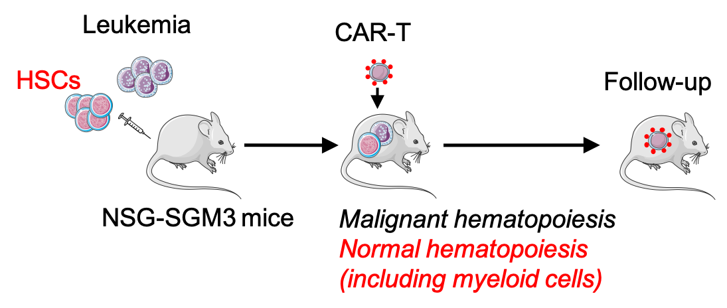
Humanized model for CAR-T
Efficacy and CAR-related toxicities

Slide 12
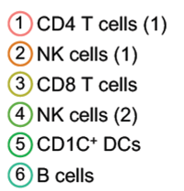
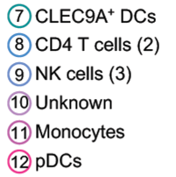
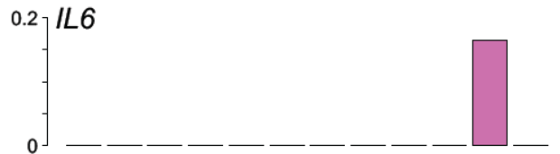
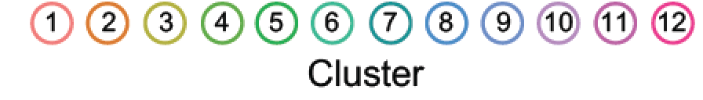
Role of monocytes in CRS
IL-6 sources
Monocyte’s ablation

Slide 13


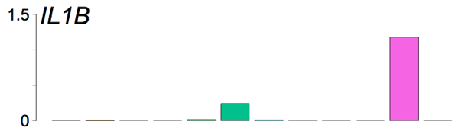
IL-1 precedes IL-6 release
IL-1 source
IL-1 kinetics
In vivo
IC staining monocytes
In vitro co-cultures
19.CAR28z + target + mTHP-1

Slide 14
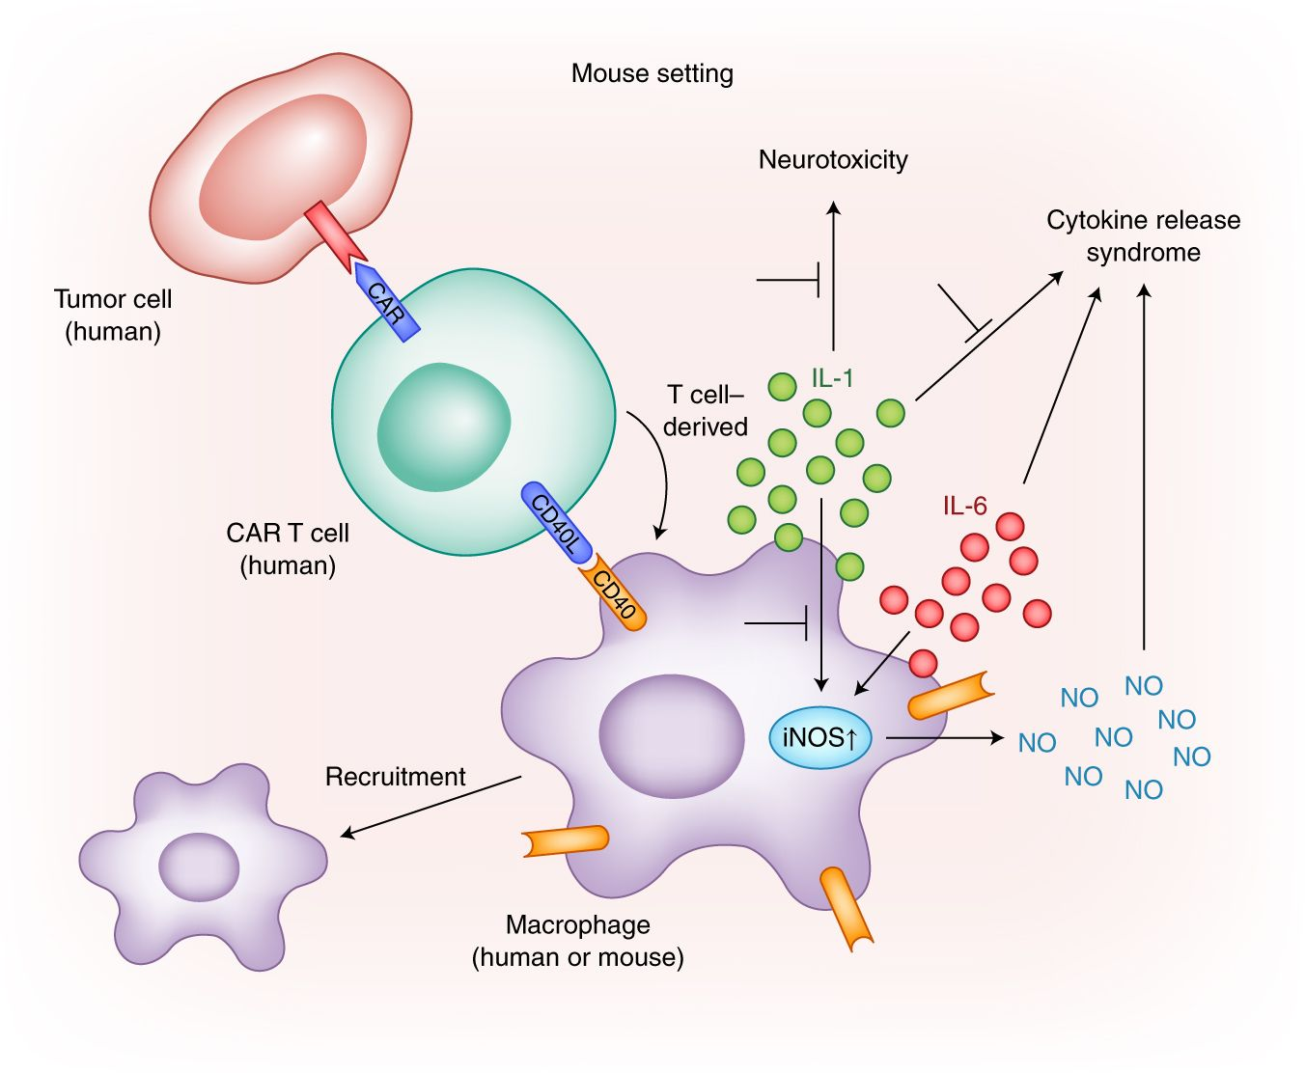
CRS initiating cascade
CAR-T cells release perforin to form pores, leading to the entry of granzyme B into target tumor cells, which causes the subsequent activation of GSDME and pyroptosis (programmed necrotic cell death)
Proptosis supernatants contain ATP and HMGB1 that induce macrophages to release IL-1b
and IL-6, respectively
Liu YL, et al. Science Immunol 2020; 5: eaax7969

Slide 15
Main CAR-related toxicities
Neurotoxicity
Cancer | Site | CAR | Severe NTX (%) | Reference
B-ALL | NCI | 28z | 5 | Lee, Lancet 2015
B-ALL | MSKCC | 28z | 42 | Park, NEJM 2018
B-ALL | FHCC | BBz | 50 | Turtle, JCI 2016
B-ALL | Multiple ELIANA | BBz | 13 | Maude, NEJM 2018
NHL | Multiple ZUMA-1 | 28z | 28 | Neelapu, NEJM 2018
NHL | Multiple JULIET | BBz | 12 | Schuster, NEJM 2019
NHL | FHCC | BBz | 28 | Turtle, STM 2016
CLL | UPenn | BBz | 7 | Porter, STM 2015
CLL | FHCC | BBz | 25 | Turtle, JCO 2017

Slide 16
Neurotoxicity
Characterized by aphasia, delirium, headache, seizures and edema
Potentially life-threatening (cerebral hemorrhage and edema)
Characterized by endothelial activation
Characterized by increased permeability of the BBB
Typically occurs after CRS
Severe neurotoxicity is frequently associated with:
  Earlier and more severe CRS (fever and cytokines)
  Higher tumor burden
  Cy/Flu lymphodepletion
  More robust CAR-T cell expansion in vivo
  Higher CAR T-cell dose
  Neurologic comorbidities

Slide 17
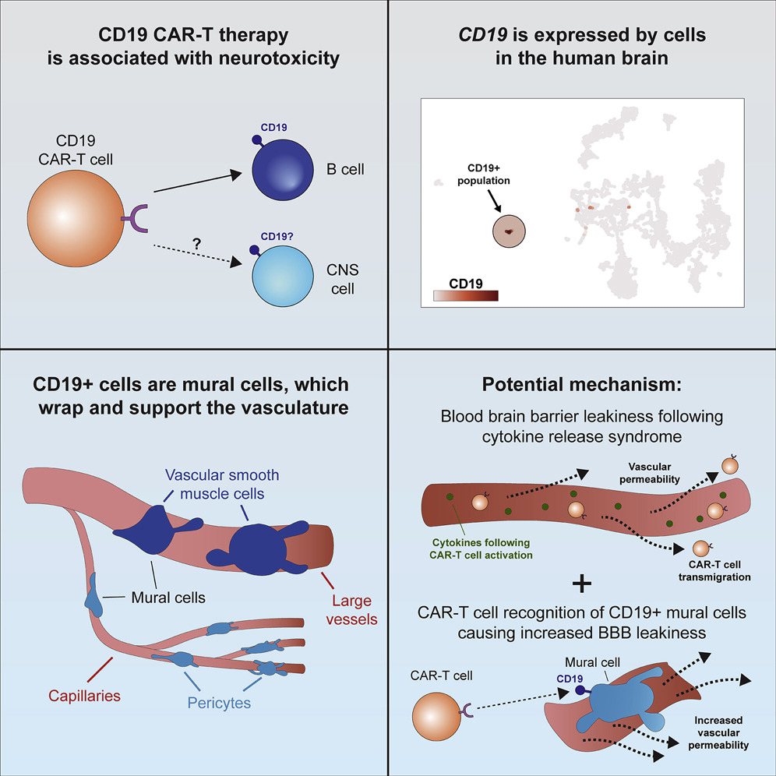
Neurotoxicity pathophysiology
1
2

Slide 18
CRS and neurotoxicity management
Tocilizumab
  Anti-IL-6R antibody
  Active against CRS
  Unable to control neurotoxicity in most of patients
Corticosteroids
  At high-doses can be detrimental for efficacy
The search for strategies
to mitigate these toxicities is extremely active

Slide 19
Mitigating CRS and neurotoxicity
Early intervention in patients at risk of developing severe toxicities
Identification of predictive biomarkers
Cytokine inhibitors
IL-6, IL-1, GM-CSF, catecholamine

Slide 20
Anakinra abolished neurotoxicity in mice
CRS

Slide 21
Mitigating CRS and neurotoxicity
Early intervention in patients at risk of developing severe toxicities
Identification of predictive biomarkers
Cytokine inhibitors
IL-6, IL-1, GM-CSF, catecholamine
On/off switches
Pharmacological control over CAR T-cell activity (drugs or CAR designs)

Slide 22
On/off switches to mitigate toxicity
Short treatment with dasatinib can rapidly and temporary switch-off CAR T-cell function
CAR constructs able to induce full T-cell activation only upon administration of a dimerizing agent
CAR constructs including a domain that enable drug-dependent degradation of the CAR protein

